Slide 1

What do they do?
What are CubeSats & other small satellites?
How do they adjust & maintain orientation?
CubeSat
Essential
Questions
How do they position themselves in space for a mission?

Slide 2
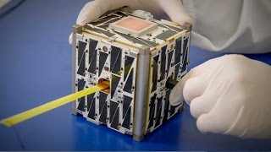
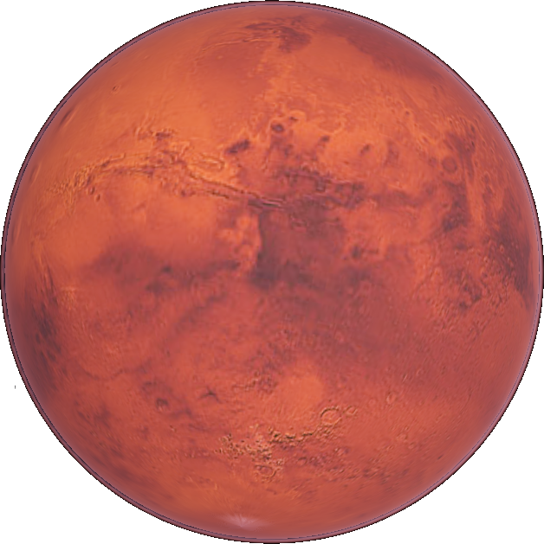
Space Spark
Day 1
Understanding Orientation
What Do You Notice? Wonder?
What is a CubeSat?
Attitude Adjustment: Dizzy Bat
Wrap-Up: Satellite I.Q.
Source: NASA/JPL
Space Trivia
Which unmanned spacecraft performed the first flyby of Mars?
Mariner 4
Telus 1
Notes:
Trivia (answer: Mariner 4)
Source: NASA/JPL

Slide 3
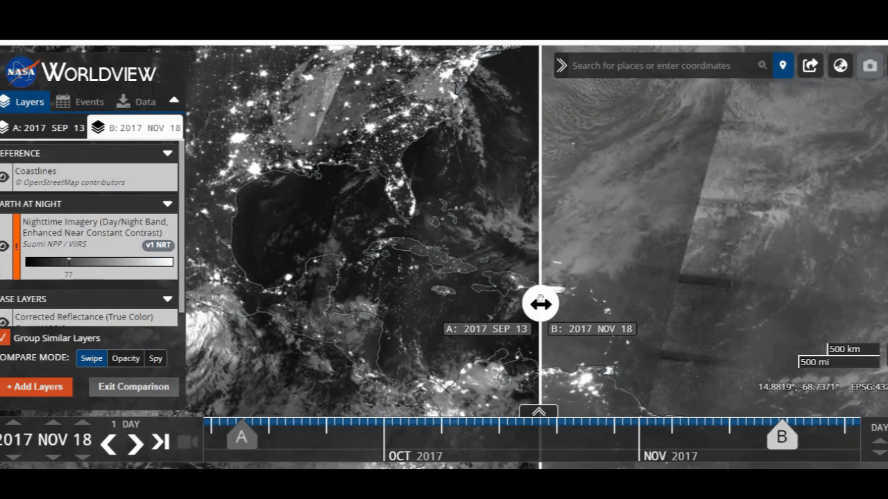
September 13, 2017 vs November 18, 2017
Source: NASA Worldview
What do you notice? What do you wonder?
Notes:
Ask, “What do you notice as the image slides from Sept. 2017 to Nov. 2017?” Answers will vary and all are accepted. (Note the electricity outages in September that were not fixed until mid-November of 2017)
Ask, “What do you wonder as the image slides from Sept. 2017 to Nov. 2017?” Encourage all questions/wonderings.
Explain that these two satellite images are from before and after Hurricane Maria hit Puerto Rico in 2017 and allow scientists the ability to track the effects of the hurricane overtime. (For more information, click here.) Over the next few classes we’ll be exploring satellite and cubesat positioning in space to understand how data, like the images from Hurricane Maria, can be gathered.
NASA Worldview Source
More information here

Slide 4
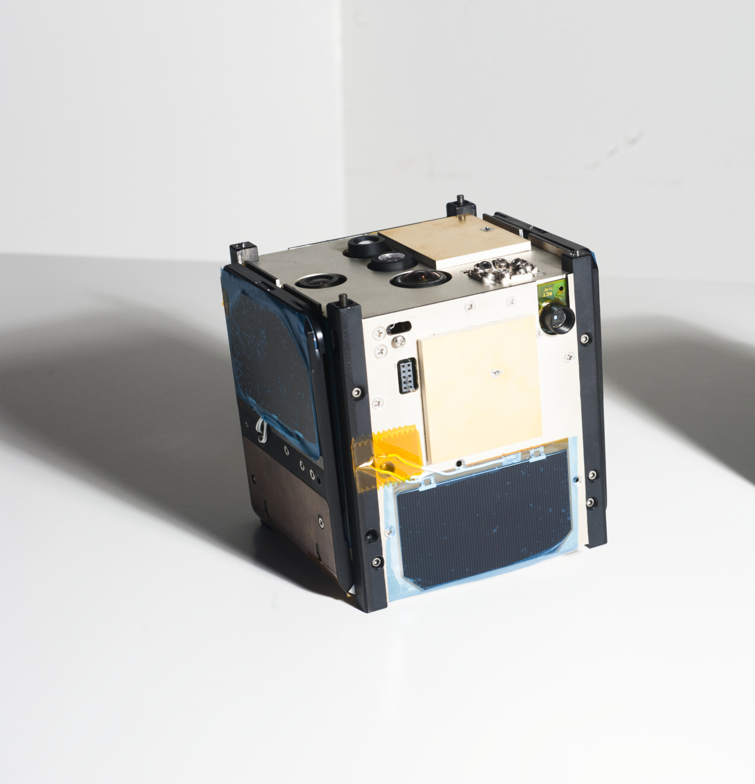
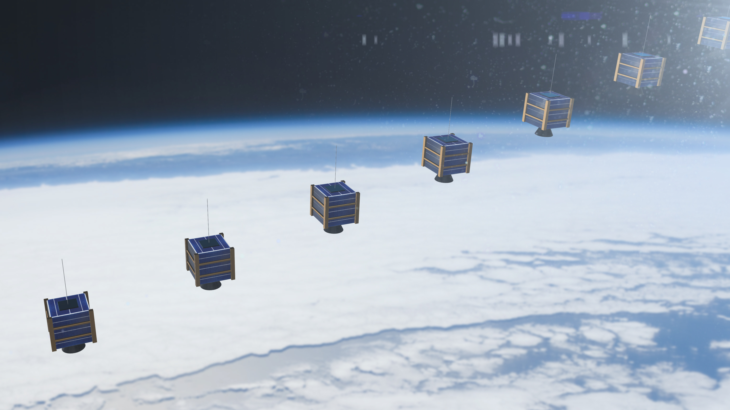
CubeSats
Cubesats are compact satellites that allows data collection from orbit in a small form factor of 10 cm³. This small form factor allows for many more cubesats to be launched into space compared to satellites of traditional sizes.
Since weight has a large impact on the cost of going to space, Cubesats allow for increased missions because many can do what much larger satellites were designed to do in the past.
Notes:
Adobe Stock and Aerospace

Slide 5
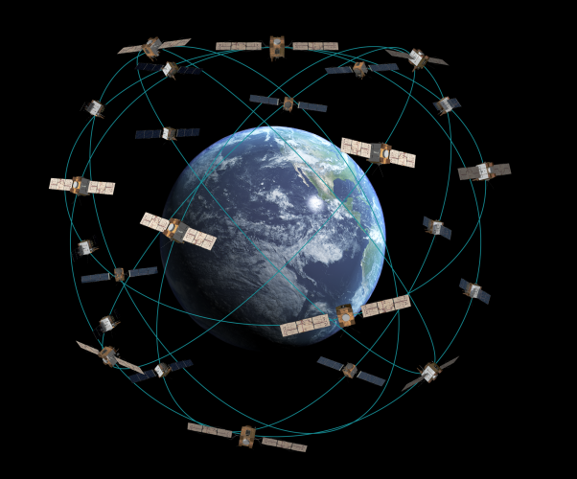
CubeSats
CubeSats are compact satellites that allow constellations to be made around the Earth in order to monitor various events.
Due to their small size, many cubesats can occupy low Earth orbit (LEO)
Despite their benefits, CubesSats still need to be controlled from the ground and complications may still arise. This is one of the purposes of this CubiKit, to understand how to orient and control a CubeSat.
Notes:
Adobe Stock

Slide 6

Section A - Dizzy Bat
Record the time for dizzy bat.
Record the time for dizzy bat with cones. 5 second penalty for each cone hit.
Record the time for dizzy bat with cones and blindfold. 5 second penalty for each cone hit.
Notes:
Adobe stock

Slide 7

Section B - Dizzy Bat Class Data
Class average for regular dizzy bat
Class average for dizzy bat with cones
Class average for dizzy bat with blindfold
Notes:
Adobe Stock

Slide 8
Section C - Strategies for Orientation
Which round was easiest for you? Why?
What senses did you rely on to navigate to your partner?
With fewer senses (when you were blind folded), how did that change your ability to navigate toward your partner? Use data to tell this story.

Slide 9
Day 1 Wrap-up:
What's Your Satellite IQ?
Interesting
I
Q
Question

Slide 10
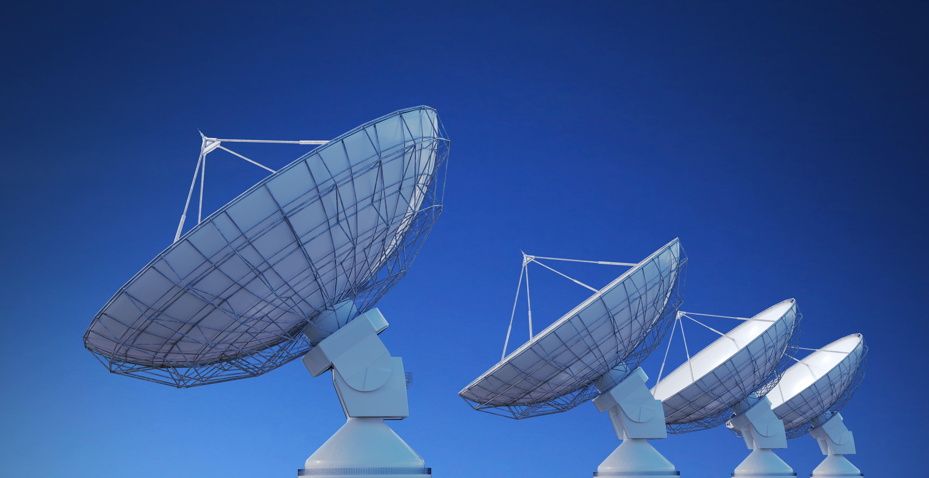
Space Spark
Day 2
Vocabulary Development
Information Transmission Simulation
Vocabulary in your words
What is Attitude & Control? (9 min)
Wrap-Up: Use your words & think a little differently.
Space Trivia
Approximately how many pieces of space junk larger than 1mm are there?
100 thousand
100
million
100 billion
Notes:
Trivia Source (answer: 100 million)
Photo, Adobe Stock
Video Link: https://www.youtube.com/watch?v=O5CJRsh5RlU

Slide 11

Section D - How CubeSats Transmit Information
Rounds of Observation:
Number of shapes
Shapes
Location of shapes
Size of shapes
Orientation of shapes
Color of shapes
Notes:
Adobe Stock

Slide 12
Section D - How CubeSats Transmit Information
What lingering questions/ wonderings do you have about CubeSat Information transmission?
Describe the successes you experienced during this activity.
Describe the challenges you experienced during this activity.

Slide 13
Section E - Vocabulary Development
Satellite
Cubesat
Navigation
Control
Torque
Drag
Orientation
Trajectory
Attitude
Gyroscope
Angular Momentum
Notes:
Missing Sources

Slide 14

Section E - What are Attitude and Control?
Watch the video.
What are the two primary external forces acting upon the ISS that require us to continually change its attitude?
What are the two methods of orienting a satellite and maintaining its attitude?
Notes:
Adobe Stock

Slide 15
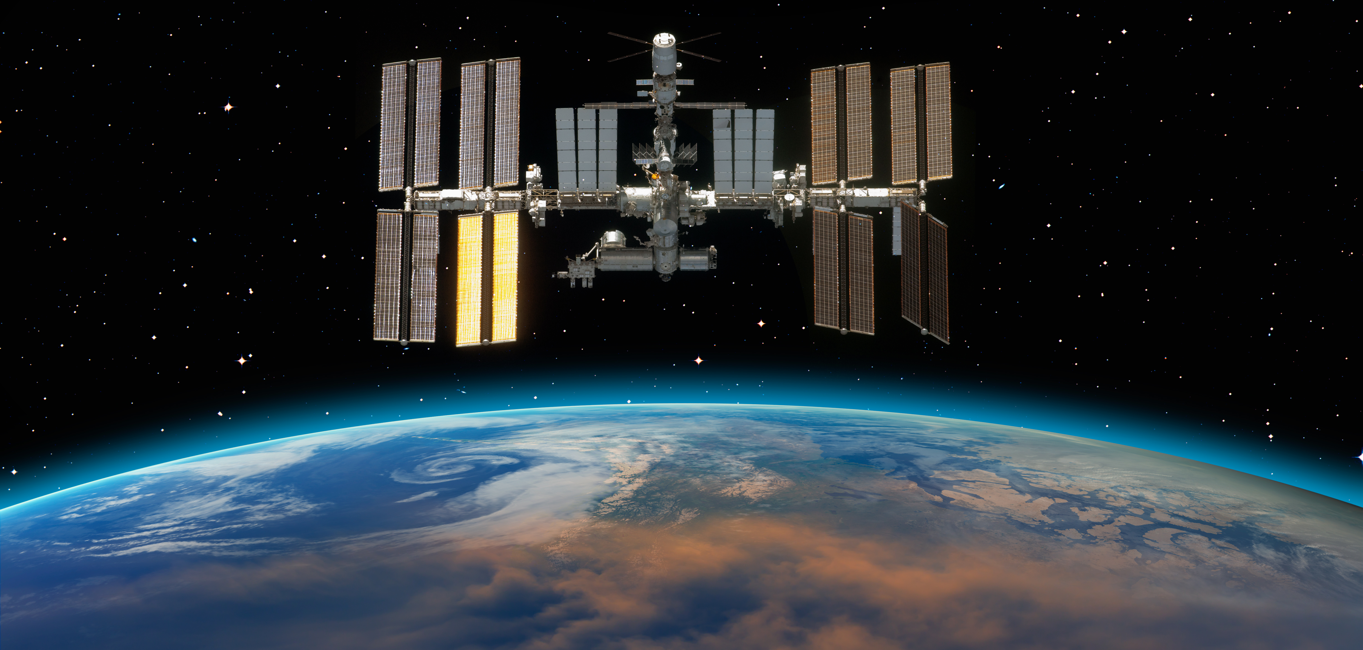
Section F - What are Attitude and Control?
What are some differences between CubeSats and the current research satellites employed by scientists?
What benefits do CubeSats have over older, larger research satellites?
Notes:
Adobe Stock

Slide 16
Use Your Words.
Use at least ___ of the words in section E
Describe the typical day of a highschool student
Share with a neighbor.

Slide 17
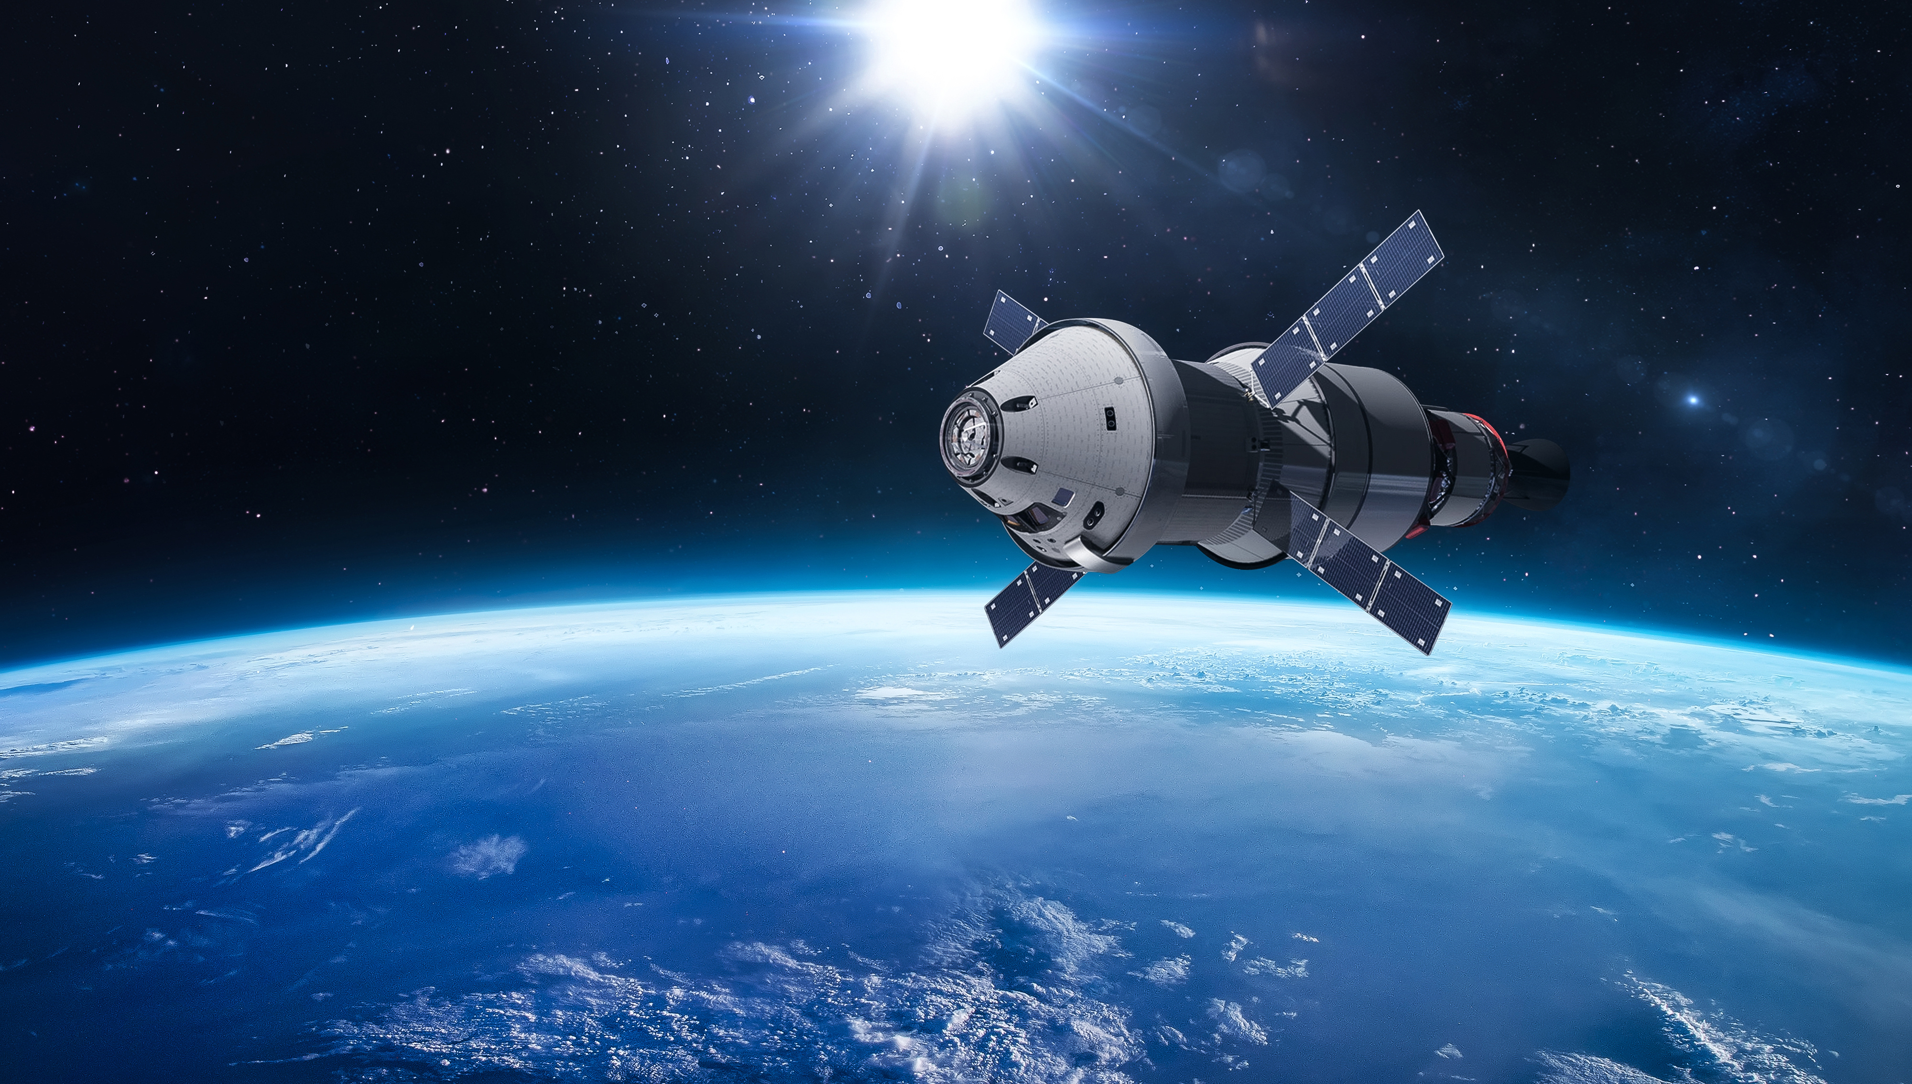
Space Spark
Day 3
Building a CubeSat
Anatomy of a CubeSat
Information Transmission Review
Case Studies
Wrap-up
Space Trivia
Voyager 1’s Golden Record contains greetings in how many languages?
55
27
12
Notes:
Trivia (55) More information:The Golden Record aboard the Voyager 1 spacecraft contains a message intended to represent Earth to potential extraterrestrial civilizations. This message includes a collection of sounds and images that represent life on Earth. The record is inscribed with greetings in 55 languages, a selection of music from various cultures, and a range of natural sounds, including thunder, birdsong, and ocean waves. It also includes a guided map to locate our solar system and Earth's position within it.
The historic message is a way to convey a snapshot of human culture and civilization to any intelligent beings who might encounter the Voyager 1 spacecraft in the distant future.
Image: Orion – Adobe Stock

Slide 18
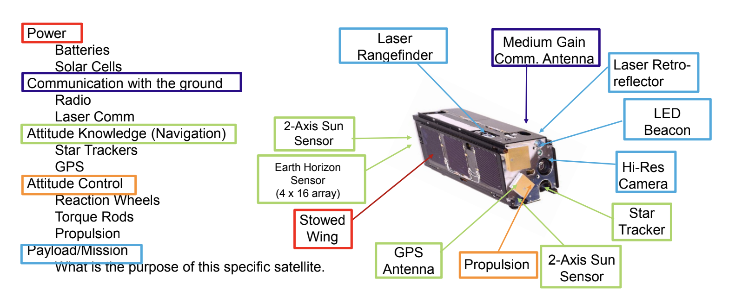
Section G - Labeling Parts of a CubeSat
1.
2.
3.
4.
12.
11.
5.
10.
6.
9.
8.
7.

Slide 19
Section H - CubeSat Transmission Process
Identify which of the 5 main components of a satellite (power, communications, attitude knowledge, attitude control, or payload/mission) were used in the activity.
What did the command for the following represent?
number of shapes
shapes
location of shapes
size of shapes
orientation of shapes
color of shapes

Slide 20
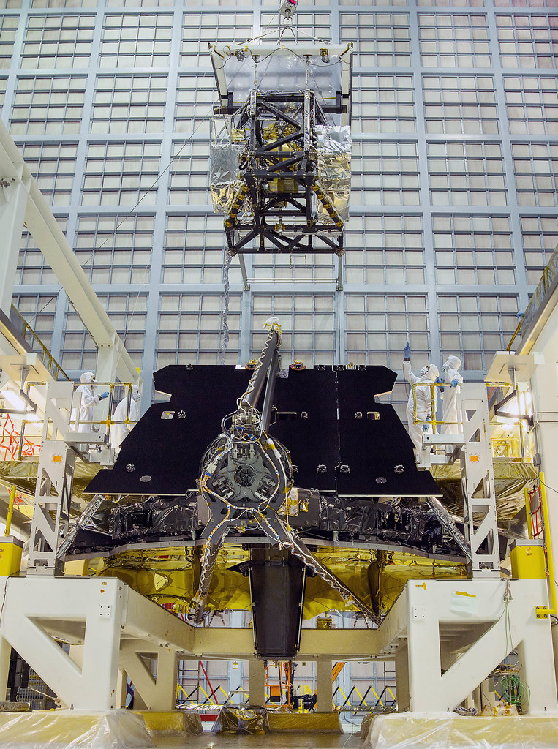
Section I - Satellite Case Study
JWST
What does this satellite observe? The satellite uses its sensors to see light from distant galaxies and stars.
What sensors does this satellite use? It has a near-Infrared camera, a near-IR Spectrograph, a mid-IR instrument, and a Fine Guidance Sensor/Near-IR Imager and Slitless Spectrograph.
How do these individual sensors come together to provide information to scientists that tell the entire story? All of these sensors together are able to take in multiple types of EM radiation and provide as much data as possible about the part of space they are viewing.
Source: NASA/ChrisGunn
Notes:
Image Credit: https://webb.nasa.gov/content/observatory/instruments/index.html

Slide 21
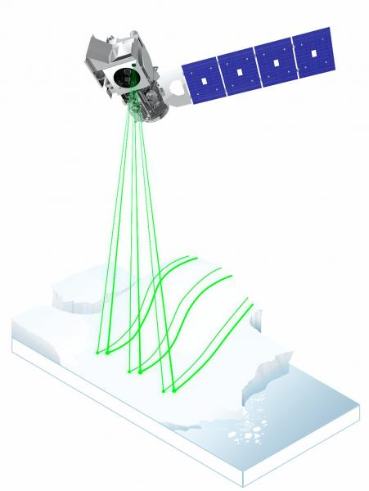
Section I - Satellite Case Study
ICESat-2
  What does this satellite observe? This satellite observes tree canopy heights, ocean and lake levels, and the elevation of ice sheets, glaciers, and sea ice.
  What sensors does this satellite use? The ICESat-2 uses six lasers split into three pairs (six total beams to better measure the earth), blasting 10,000 laser light pulses per second. These photons return to the satellite and the information is transmitted down to NASA stations on the ground.
  How do these individual sensors come together to provide information to scientists that tell the entire story? These laser light pulses can determine the height of something to within 4 millimeters, which helps them accurately predict sea level heights and rate of ice caps melting.
Source: NASA
Notes:
Image Credit: https://icesat-2.gsfc.nasa.gov/

Slide 22
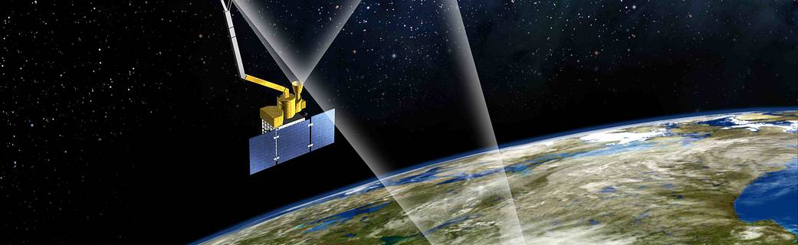
Section I - Satellite Case Study
SMAP
  What does this satellite observe? This satellite monitors the topsoil of the earth’s surface to create soil moisture estimates and identify drought locations.
  What sensors does this satellite use? The SMAP uses two microwave instruments. A radar and radiometer are a combination of active and passive radar which combine higher resolution and higher soil moisture accuracy.
  How do these individual sensors come together to provide information to scientists that tell the entire story? They are able to map the entire globe in about 3 days and gather soil moisture estimates in approximately a 6-mile resolution.
Source: NASA
Notes:
Image Credit: https://science.nasa.gov/mission/smap/

Slide 23
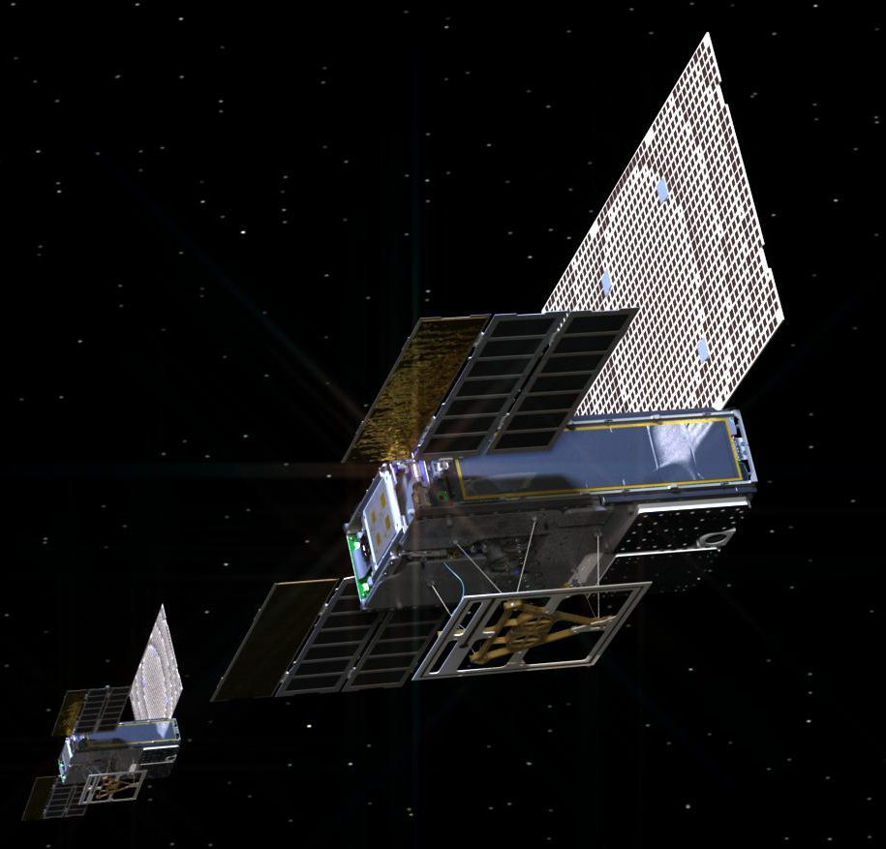
Section I - Satellite Case Study
MarCO
  What does this satellite observe? These CubeSats observe the surface of the planet Mars.
  What sensors does this satellite use? They utilize cameras, communication equipment, and navigational equipment.
  How do these individual sensors come together to provide information to scientists that tell the entire story? These two systems were able to work together to gain information about the landing location and status of another, larger project called InSight.
Source: NASA/JPL-Caltech
Notes:
Image Credit: https://solarsystem.nasa.gov/missions/mars-cube-one/in-depth/

Slide 24
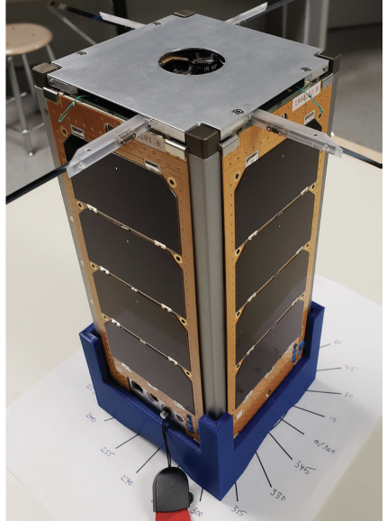
Section I - Satellite Case Study
ELaNa
  What does this satellite observe? ELaNa 36 is designed to observe forest regrowth in the Gatlinburg, Tennessee area from orbit.
  What sensors does this satellite use? The CubeSat uses a variety of cameras, a flight navigation computer, and a VHF/UHF radio for communication with the ground.
  How do these individual sensors come together to provide information to scientists that tell the entire story? Once it takes photos from orbit, it sends them back to students via the radio. It can also be remotely controlled from the ground through the use of the radio.
Source: NASA
Notes:
Image Credit: https://www.nasa.gov/sites/default/files/atoms/files/elana_36_mission_fact_sheet.pdf

Slide 25
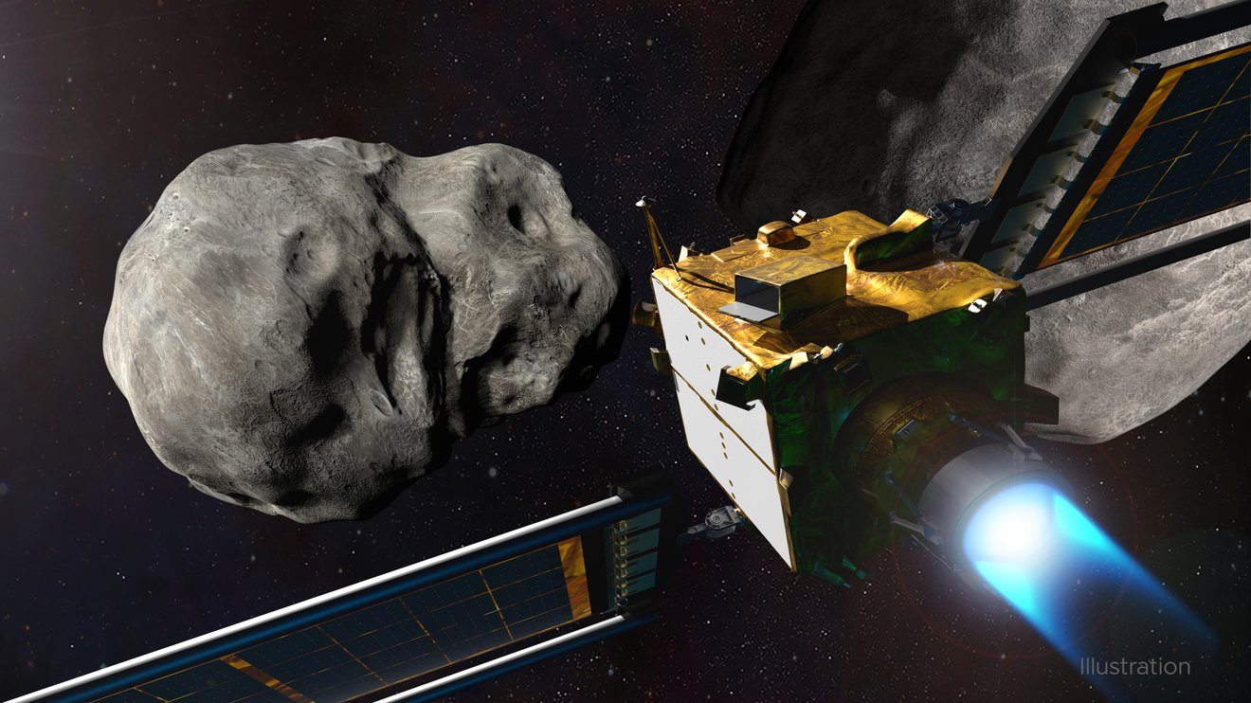
Section I - Satellite Case Study
DART
  What does this satellite observe? This satellite was designed to record the results of a small spacecraft slamming its mass directly into an asteroid to determine if the impact will sufficiently redirect the course of the asteroid.
  What sensors does this satellite use? The CubeSat companion for the DART program uses two optical cameras.
  How do these individual sensors come together to provide information to scientists that tell the entire story? The information recorded by the optical cameras can be sent back to scientists on the ground, who will be able to determine whether or not ramming the asteroid with the spacecraft achieved the expected result.
Credit: NASA/Johns Hopkins APL/Steve Gribben
Notes:
Image Credit: https://www.jpl.nasa.gov/news/nasas-asteroid-striking-dart-mission-team-has-jpl-members

Slide 26
Day 3 Wrap-up:
How do these case studies relate to the transmission process activity?
Just like in the activity, a single sensor acting alone was not able to provide all of the necessary information. Having more sensors allows scientists to gather more information than they would be able to otherwise.

Slide 27
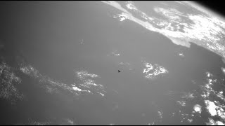
Space Spark
Day 4
CubiKit Mission
Get to Know Your CubiKit
Ground Control Teams: Establish a Commander
Establish Communication & Complete Systems Check
Achieve Mission Objective
Space Trivia
About how long was Sputnik 1 in orbit?
3
years
3 months
3
days
Notes:
Trivia (3 months) Student Handout for CubiKit Mission
Credit: Aerospace Video

Slide 28
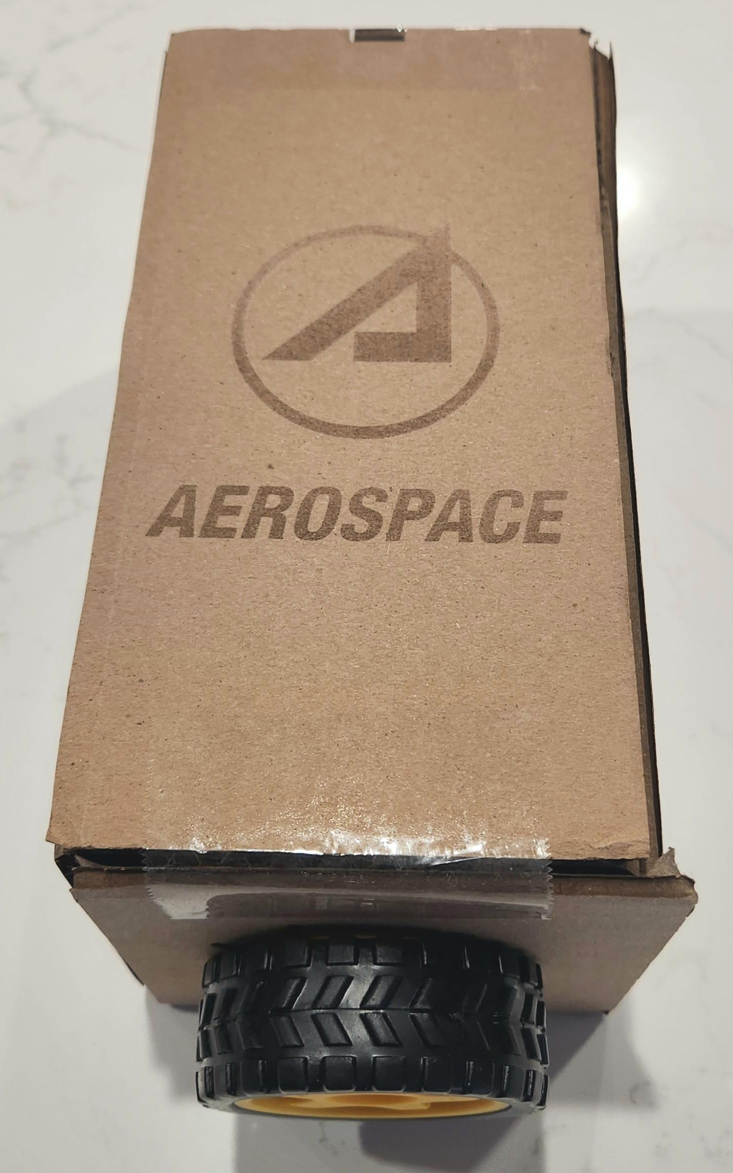
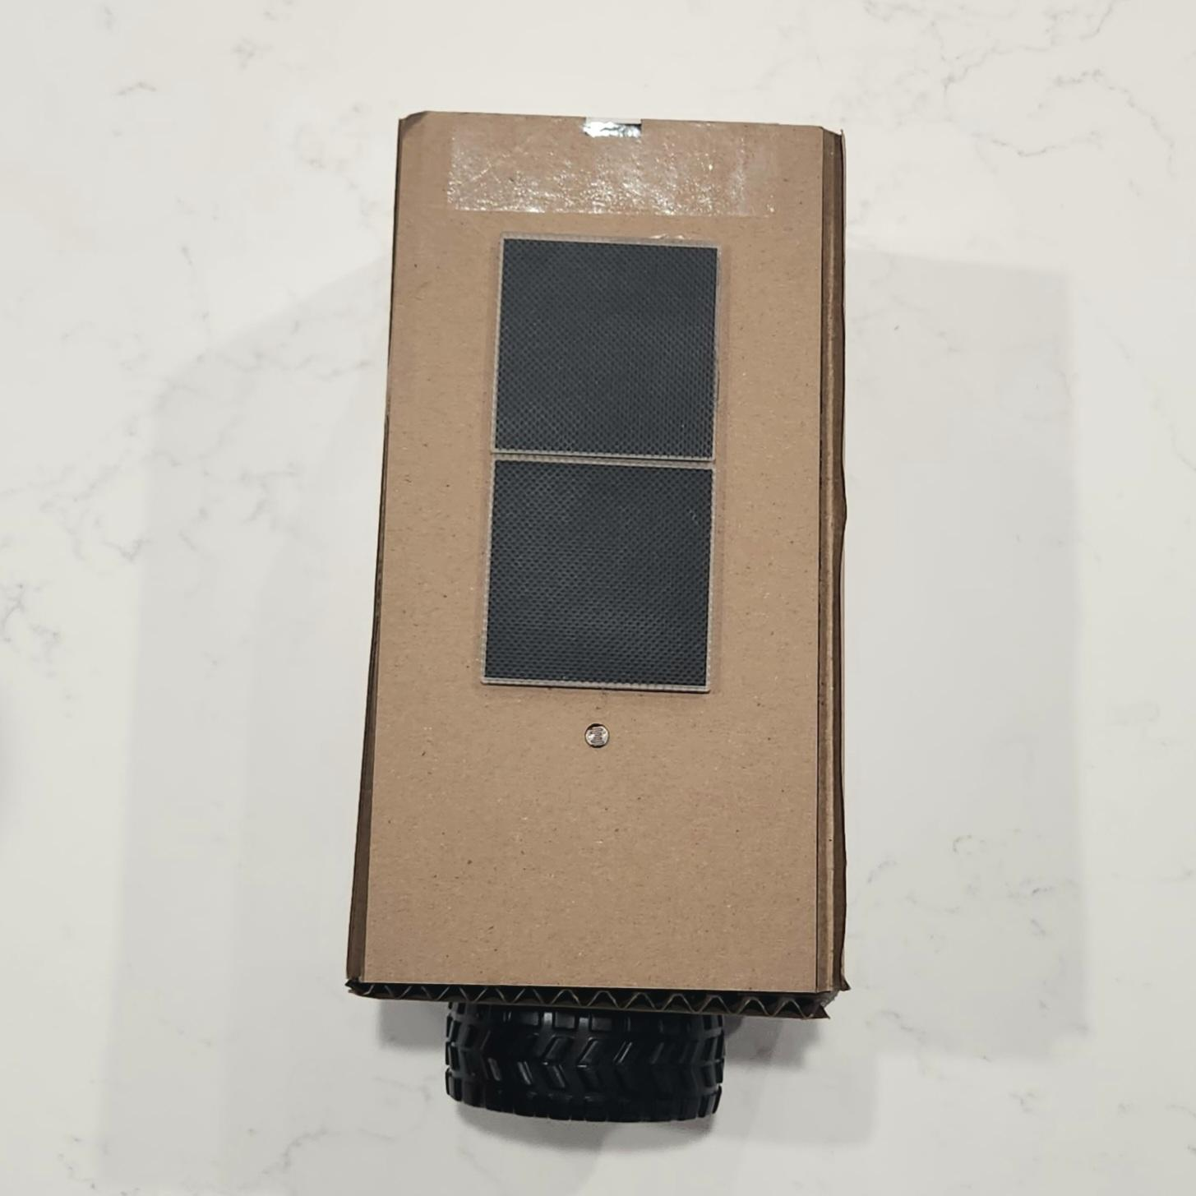
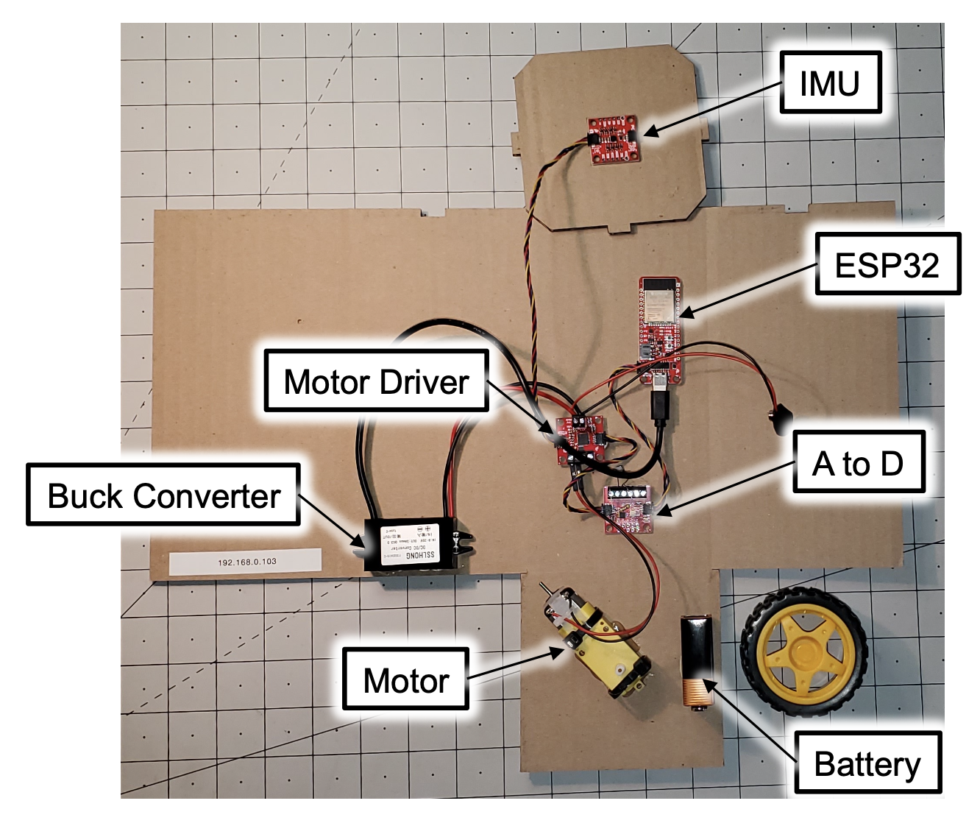
CubiKit
Notes:
Aerospace Photos

Slide 29
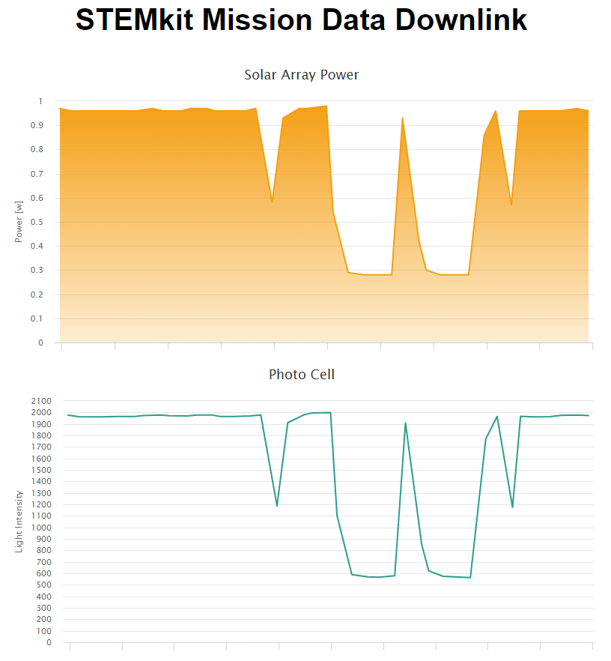
Solar Panel
The solar panel absorbs a particular spectrum of light and converts it to electrical energy to be used in the circuit. In the data link page (once the computer is connected to the CubiKit), you will see the power output measured in Watts (W).
Sample
Data
Chart
Notes:
Photo from cubikit

Slide 30
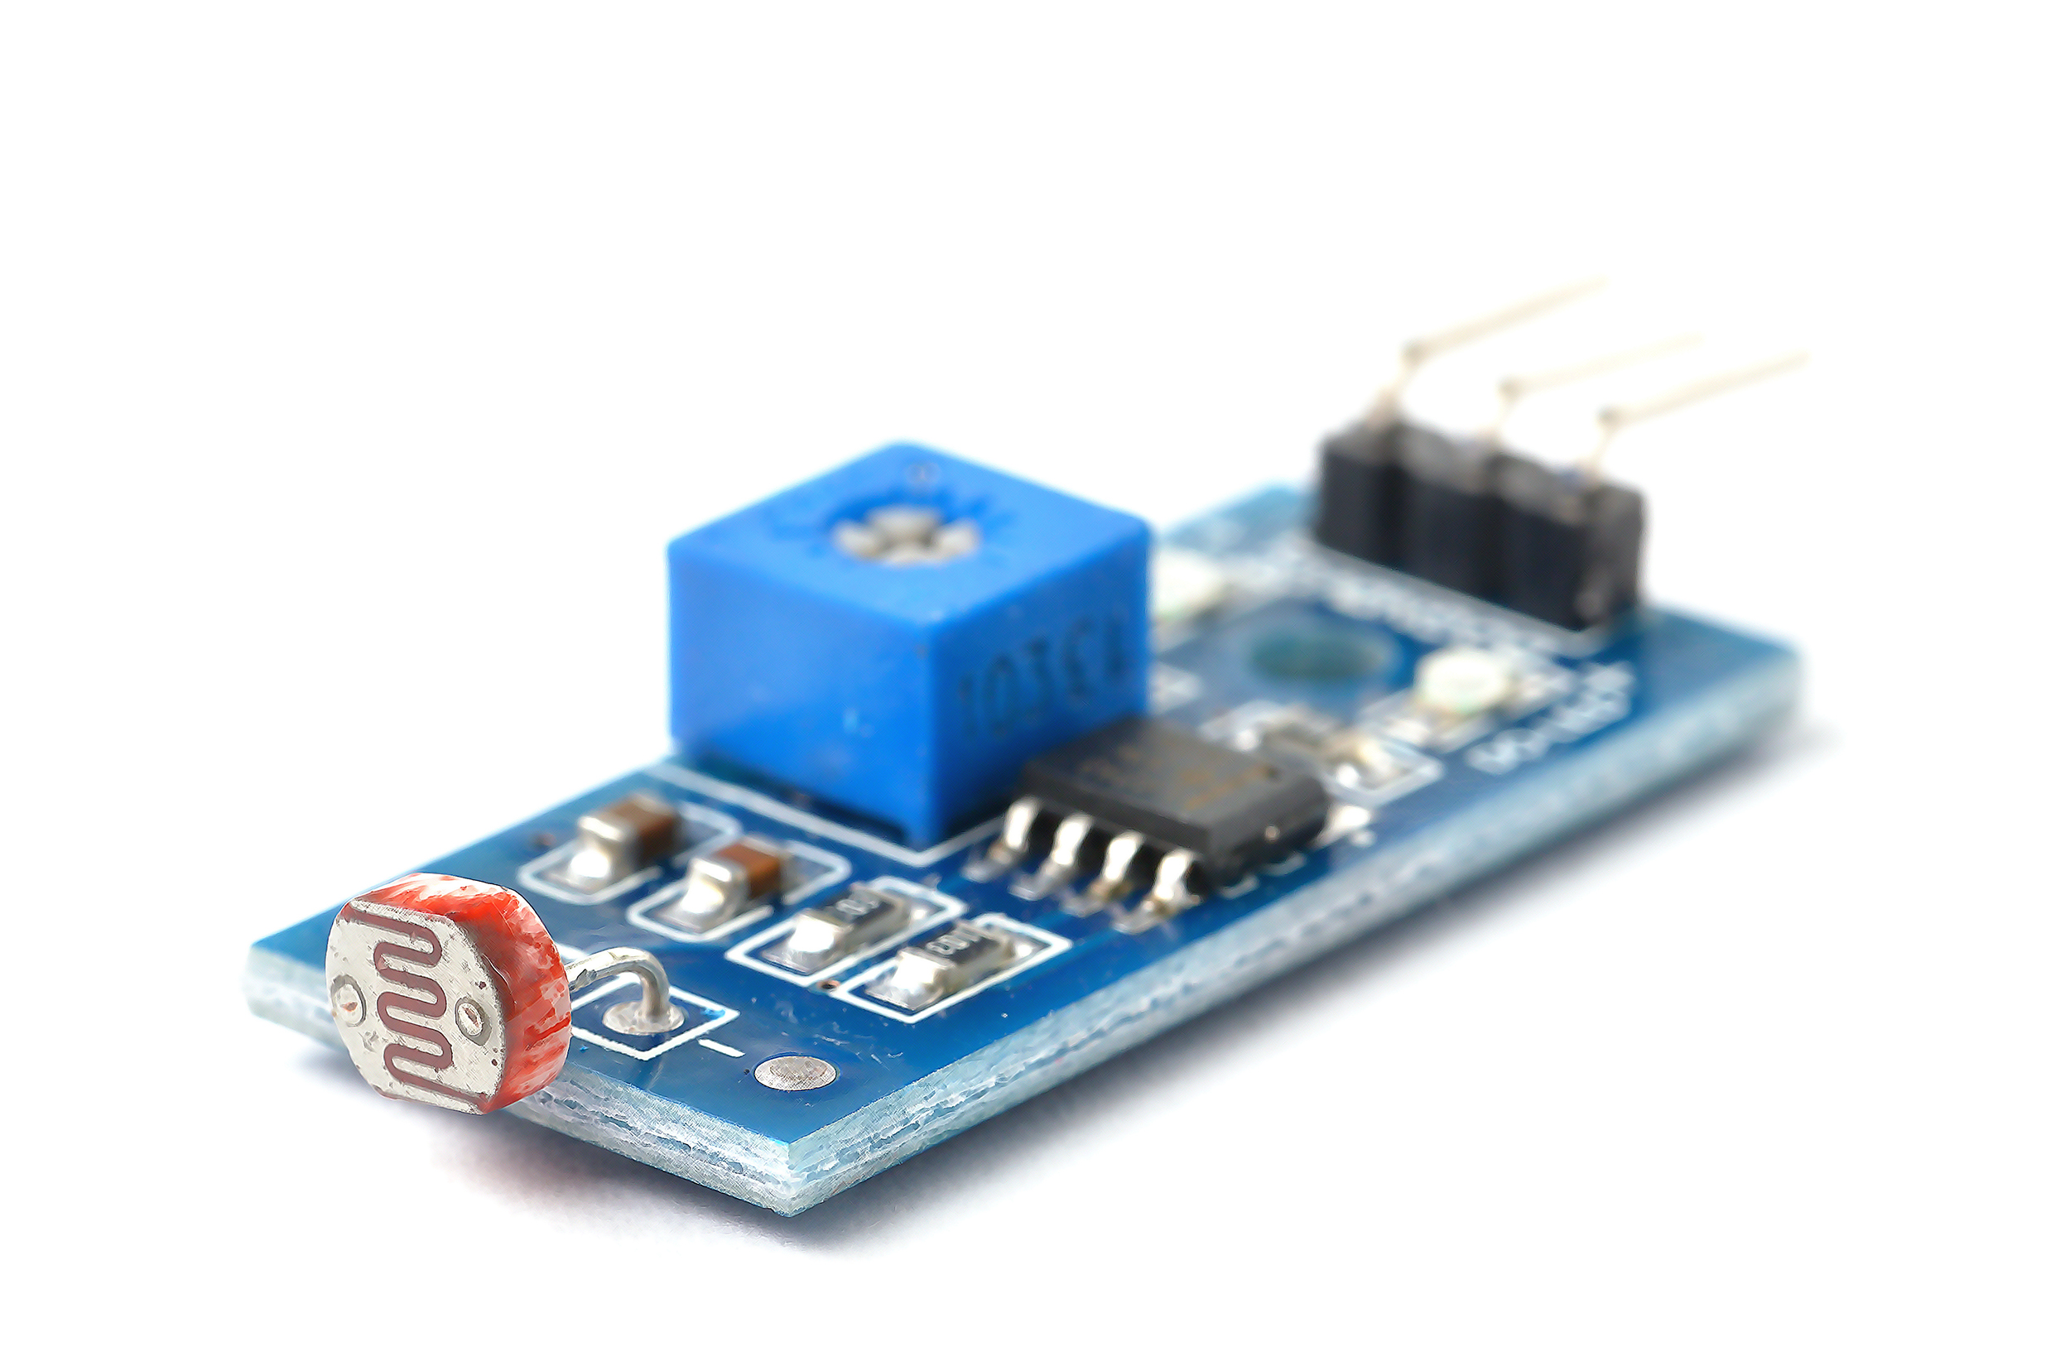
Photocell (Sun Sensor)
The photocell measures light intensity (lumens/m²) and is what is referred to as the Sun Sensor. This simulates the real sun sensors that CubeSats use to orient themselves when in orbit.
Sample
Data
Chart
Notes:
Adobe Stock

Slide 31
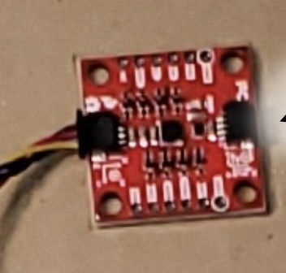
Inertial Measurement Unit (IMU)
Gyroscope
02
Accelerometer
01
03
Magnetometer
Notes:
Photo from kit

Slide 32
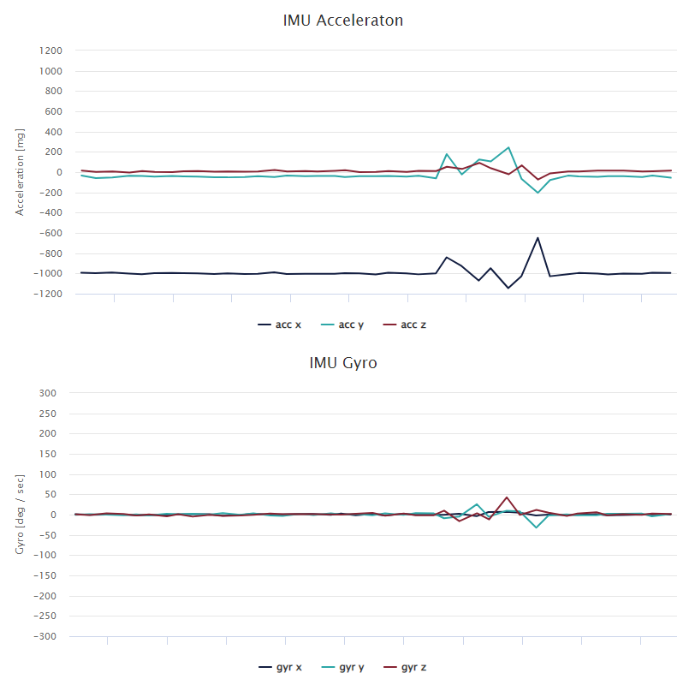
Inertial Measurement Unit (IMU)
IMU Accelerometer
  Measures the acceleration the CubiKit is experiencing in the x, y, and z directions. Units are in mili-G where G is the gravitational constant 9.81m/s² (Milli-G is 1/1000th of 9.81m/s²).
Sample
Data
Chart
Notes:
Photo from kit

Slide 33
Inertial Measurement Unit (IMU)
IMU Gyroscope
  Measures the amount of rotation the CubiKit is experiencing about the x, y, and z axes. Units are in degrees per second (deg/sec)
Sample
Data
Chart
Notes:
Photo from kit

Slide 34
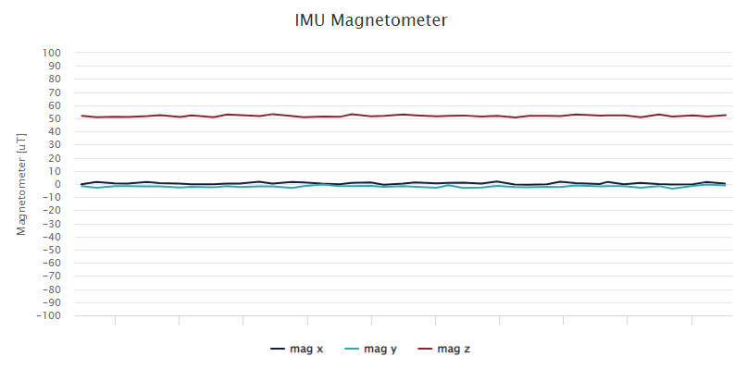
Inertial Measurement Unit (IMU)
Magnetometer
  Measures the relative amount of magnetic field in the local area around the IMU on the CubiKit. Units are in microteslas (𝜇T)
Sample
Data
Chart
Notes:
Photo from kit

Slide 35
CubeSat Mission
Mission Objective
The objective for the mission is for your ground control team to establish communication with your spacecraft, run a systems check, and orient the cubesat to track the sun.
  Mission Success -
    establish communication with the cubesat
    display understanding of the data components of the cubesat
    complete system check of
      Solar Array
      Photocell
      Inertial Measurement Unit (IMU)
        Acceleration
        Gyroscope/Rotation
        Magnetometer/Magnetic Fields
    Confirm successful tracking of sun with data

Slide 36
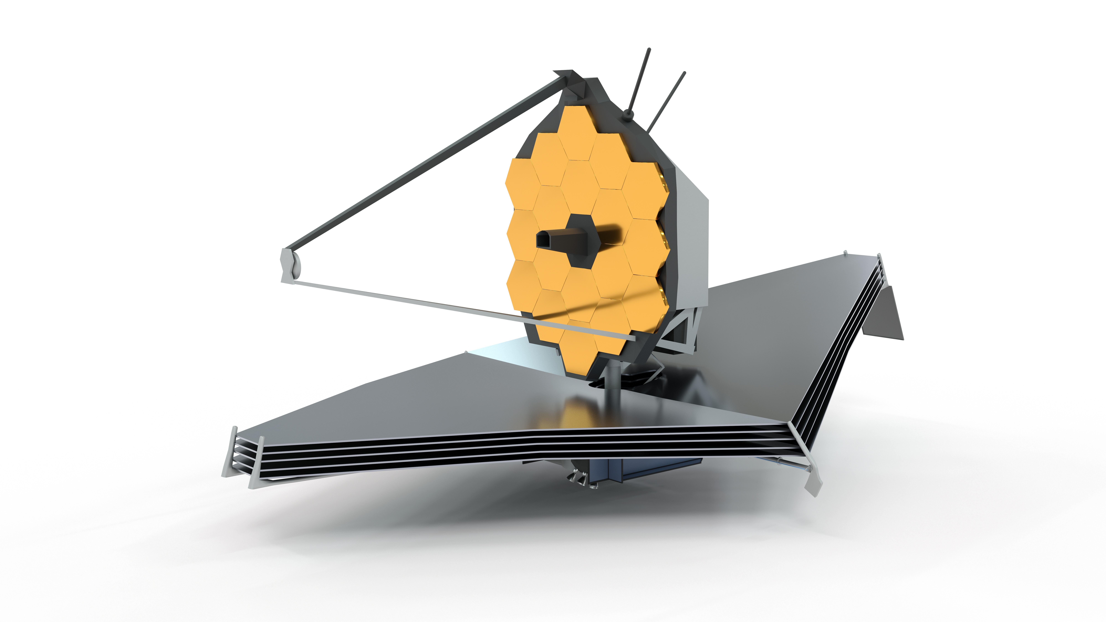
Space Spark
Day 5
CubiKit Mission
Assist the ERROR Team
  Experience the Problem
  Diagnose the problem
  Implement a Solution
CubiKit Wrap-up
Space Trivia
How much gold covers the 18 mirrors on the James Webb Space Telescope?
2
ounces
200
ounces
2,000 ounces
Notes:
Trivia (less than 2 oz) More information
Adobe Stock

Slide 37
Wrap-Up
Poetry for People
Who Can’t Rhyme
Force an Analogy
Write a haiku about cubesats and satellite missions. (Remember, a haiku is a short 3-line poem following the 5-7-5 syllable format.)
Explain how cubesats are like a ________ (see your flight director for the object/ action).
Share Your Thoughts
Techno-Jargon Rap
Revisit the case studies and rank the projects based on their importance.
Justify your most important and least important choices with an explanation.
Write (and maybe perform) a continuation & happy ending to the ERROR team member’s stress-induced rap including your data analysis and solution your team offered.

Slide 38
What do they do?
What are CubeSats & other small satellites?
How do they adjust & maintain orientation?
CubeSat
Essential
Questions
How do they position themselves in space for a mission?

Slide 39
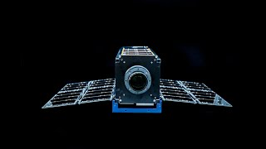
Space Spark
Alternate
Space Trivia
NASA’s SLS rocket generates more thrust than the Apollo-era Saturn V. How much more thrust does it generate?
10 %
12%
15%
Notes:
Trivia (15) More information
Credit: Aerospace Moonlighter

Slide 40
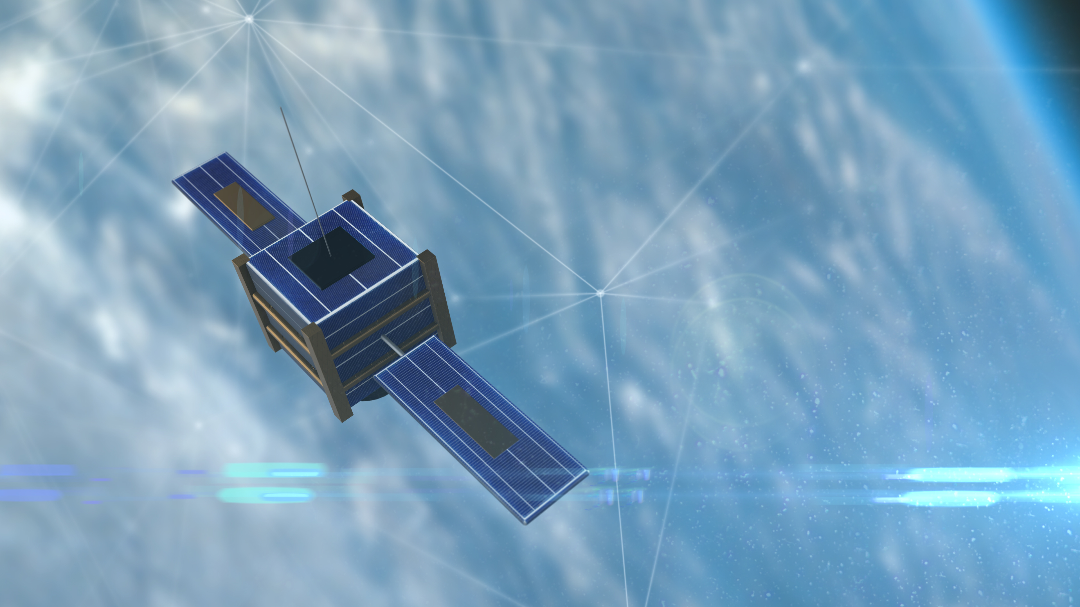
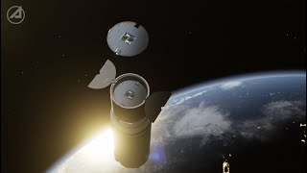
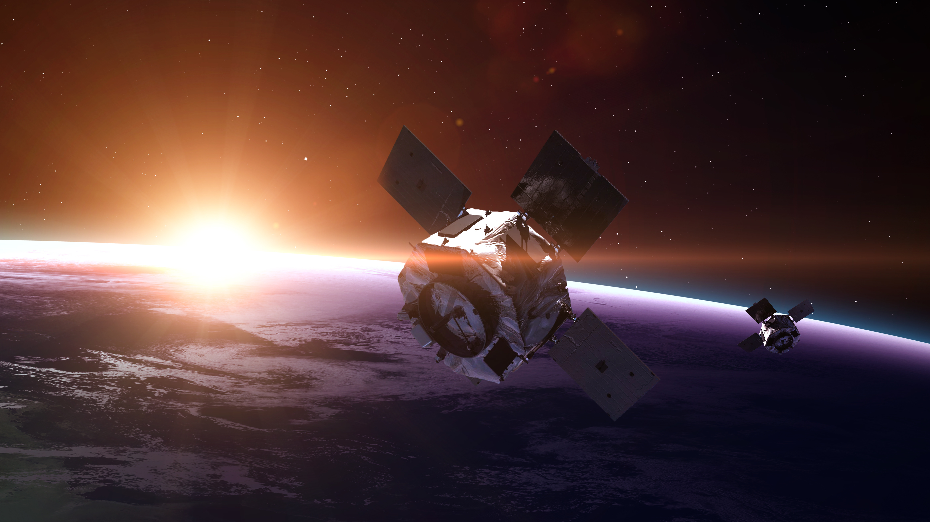
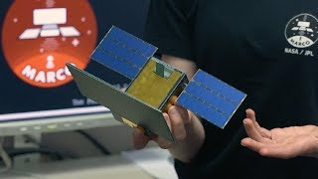
Space Spark
Alternate
Sparks
Space Spark
Space Spark
Space Spark
Source: NASA/JPL
Notes:
1: Adobe Stock
2: Aerospace
3: Adobe Stock
4: NASA JPL

Slide 41
Alternate
Trivia
Space Trivia
Which cartoon character was featured on a shuttle program patch?
Woody Woodpecker
Mickey Mouse
George Jetson
Bugs Bunny
Space Trivia
Satellites and space debris orbiting Earth increase the overall brightness of the night sky by how much?
1%
2%
3%
Notes:
Which cartoon character was featured on a shuttle program patch? (Answer: Woody Woodpecker-Over the course of a month, security cameras caught, but no one noticed, a woodpecker drilling 71 holes on the external tank of a shuttle for STS-70 mission.)
Satellites and space debris orbiting Earth increase the overall brightness of the night sky by how much? (Answer: 1%) & possible spark video

Slide 42
Credits
Special thanks to all the people who made and released these awesome resources for free:
Presentation template by SlidesCarnival
Notes:
https://www.slidescarnival.com/iris-free-presentation-template/3923

