Slide 1
Good Neighbors: How and When to Share Spectrum
Matthew Clark, PhD
Spectrum Management and Space Communications Policy
August 15, 2019
Approved for public release. OTR 2019-01025.

Slide 2
US Spectrum Policy Development

Slide 3


Frequency Bands and Spectrum Regulation
The current regulatory structure enables compatibility between different users without requiring intensive day-to-day coordination
Allocations ←Services ←Users
Regulators ensure
accountability
Develop rules and
authorize users
Non-Federal Use Federal Use
Virtually all of the useful spectrum has already been allocated

Slide 4
The New Paradigm
Spectrum Sharing … in Every Dimension
Space
Broad endorsement of sharing:
  NTIA
  PCAST Report
  President’s Memorandum…
What it takes
  Understanding participants’ requirements and characteristics
  Systems and use cases that are suited to sharing similar spectrum
  Consideration for growth and maintenance as requirements change
Different sharing mechanisms for different cases
  Geographic
  Distributed sensing
  Centralized spectrum access systems
Time
Frequency
Sharing requires greater understanding of everyone’s requirements
Notes:
See https://www.ntia.doc.gov/blog/2016/why-sharing-answer-rising-demand-spectrum for recent comments by Paige Atkins/NTIA on the role of “sharing” to address increasing spectrum demand.

Slide 5
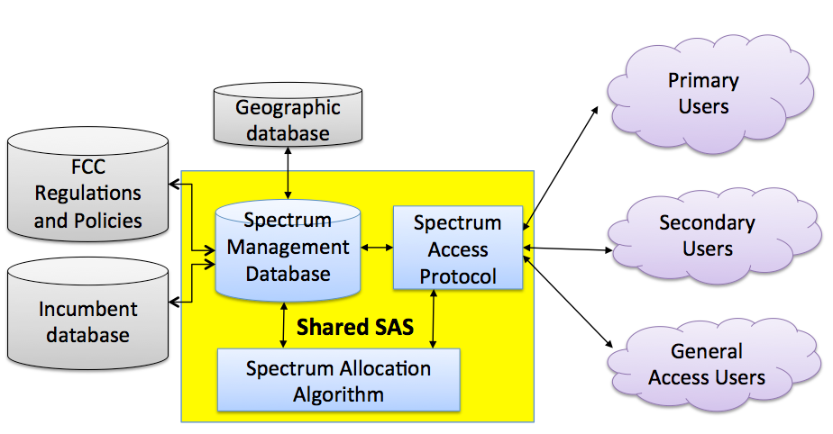
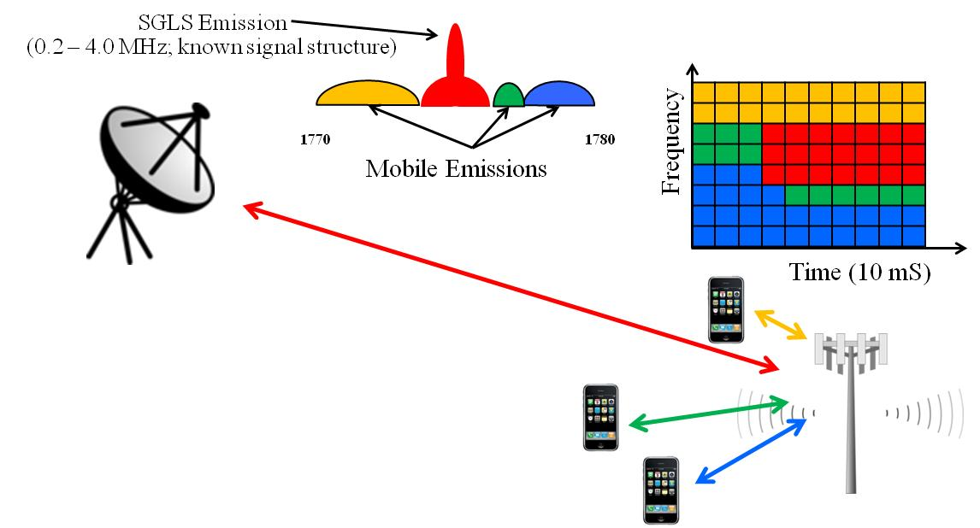
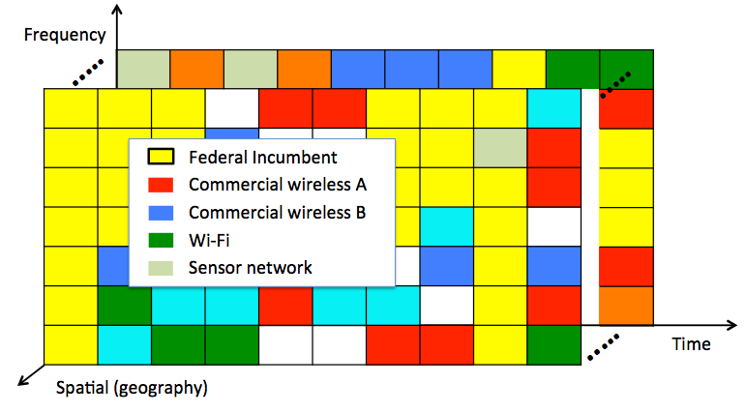
Spectrum Sharing Technologies
Increased spectrum sharing critical for meeting demand
  Spectrum sensing
  Dynamic frequency selection and cognitive radio
  Antenna systems: dynamic beamforming, nulling, shielding, and MIMO/spatial multiplexing
  Signal processing, cancellation, multi-user detection
  Spectrum Access Systems
No one size fits all solution
  Harmful interference
  Value of spectrum
  Cyber and Operational Security (OPSEC)
  Cost and complexity
Aerospace Spectrum Sharing Testbed
Spectrum Sharing System Modeling
User Network Modeling
Algorithm Optimization
Performance and Security Analysis
Notes:
Wide array of new demands for spectrum requires improvements in effective and efficient access
Aerospace is assisting customers in understanding prospects and limitations with new sharing technologies
-Spectrum sensing
-Dynamic frequency selection and cognitive radio
-Multi antenna systems, dynamic beamforming and MIMO/spatial multiplexing
-Spectrum Access Systems, e.g., CBRS. Aerospace research on:
-optimizing access system protocols
-evaluating performance versus privacy/OPSEC
-development of a spectrum sharing software testbed
No one size fits all solution. Sharing implementation should be tailored to services/systems involved
-Considerations for reliability in avoiding interference, amount/value of spectrum made available for new services, security/privacy, cost/complexity

Slide 6
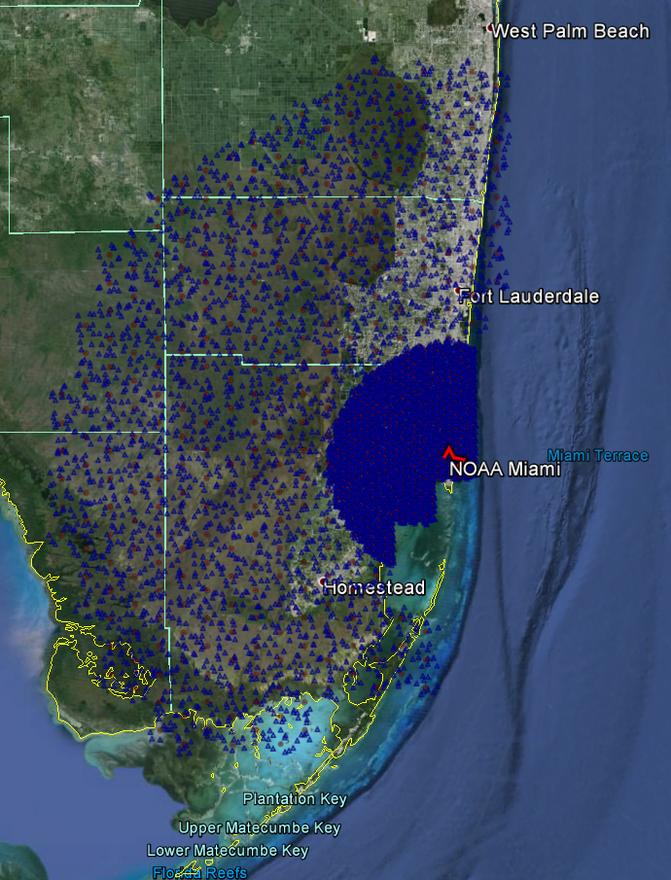
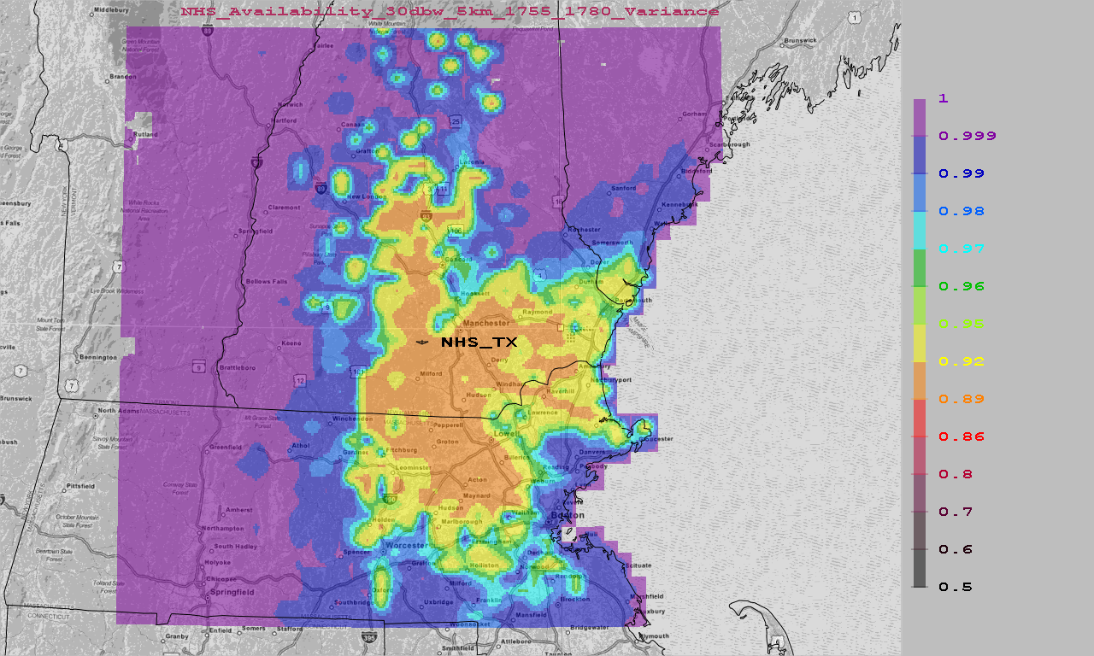
Spectrum Sharing - Space and Mobile Wireless
AWS-3
  NOAA meteorological satellite downlinks and DoD Satellite Operations (SATOPS) uplinks sharing with 4G LTE
  DoD sharing with Electronic News Gatherers
World Radiocommunication Conference 2019 Agenda Item 1.13
  High band/bandwidth spectrum for 5G
Needs for additional low/mid-band spectrum
  Internet-of-Things, vehicular networking, smart-everything, distance-everything
  Citizens Broadband Radio Service, C-band
  Broader scope of spectrum needs –challenging bands/sharing situations may be revisited
Protection Zone for NOAA in Miami
SATOPS Impact to LTE near Boston
Notes:
AWS-3
-DoD Satellite Operations uplinks and NOAA meteorological satellite downlinks sharing with 4G LTE
- Geographic sharing solutions – Aerospace conducted feasibility analysis, worked with the government to identify sharing criteria, and is continuing to support implementation/coordination
– System (space and LTE) modeling, propagation, user demand, sensing/enforcement
-DoD sharing with Electronic News Gatherers –Aerospace provided initial feasibility analysis and continues to facilitate coordination
-Near-term geographic approach
-Long-term interest in dynamic solutions.
WRC-19 AI 1.13
-Driven by need for mmWave for 5G
-24.25-27.5 GHz , 37-40.5 GHz, 42.5-43.5 GHz, 45.5-47 GHz, 47.2-50.2 GHz, 50.4 52.6 GHz, 66-76 GHz and 81-86 GHz, which have allocations to the mobile service on a primary basis; and
–31.8-33.4 GHz, 40.5-42.5 GHz and 47-47.2 GHz, which may require additional allocations to the mobile service on a primary basis.
-Aerospace customers have a stake in downlink bands (EESS, SRS) with fixed receive sites where geographic solutions are anticipated to be workable, likely on national levels
–Aerospace applied similar approaches as used in AWS-3 to assess compatibility
-Assessed plausibility of IMT system parameters proposed for analysis – appears skewed towards a more favorable sharing conclusion
-Have not specifically assessed uplink or passive/active sensing bands. Aggregate interference a concern.
Future needs for additional low/mid-band spectrum anticipated
-Internet-of-Things, vehicular networking
-Broader scope of spectrum needs – expect more challenging bands/sharing situations to be revisited
-Many uplink, passive/active sensing and some crosslink bands a challenge due to aggregate interference
-VSATs and MSS/ESIMS would require major constraints, new technology solutions and/or new mobile wireless architectures

Slide 7
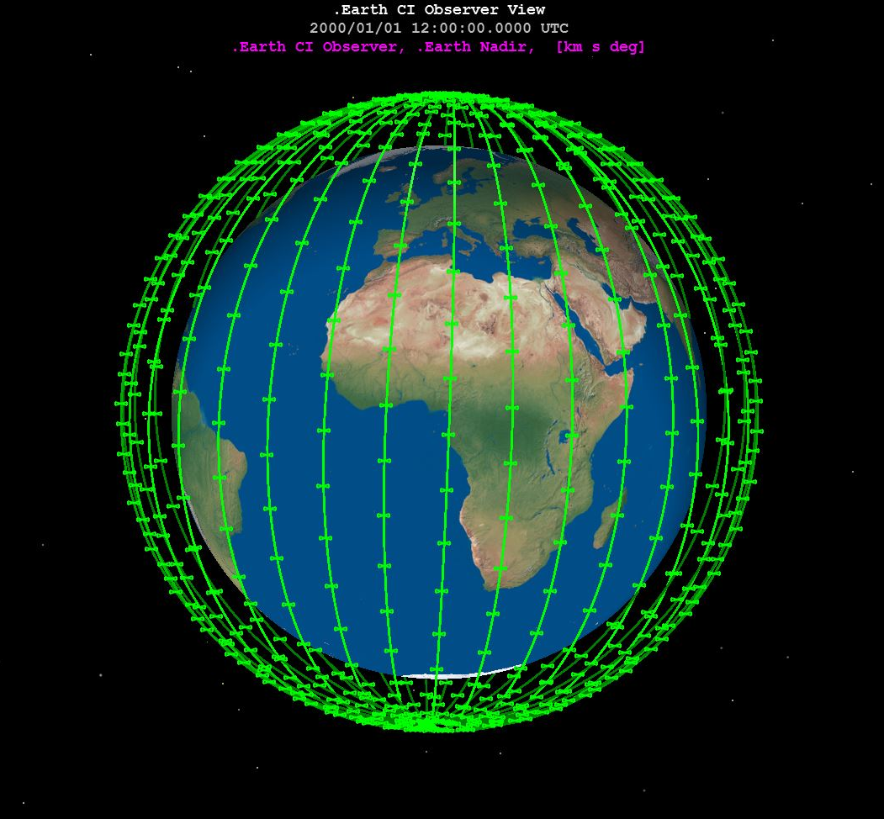
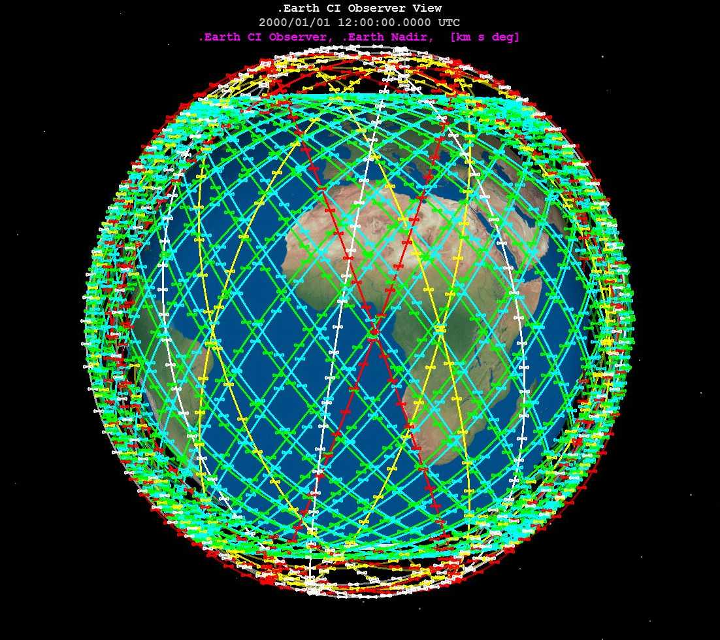
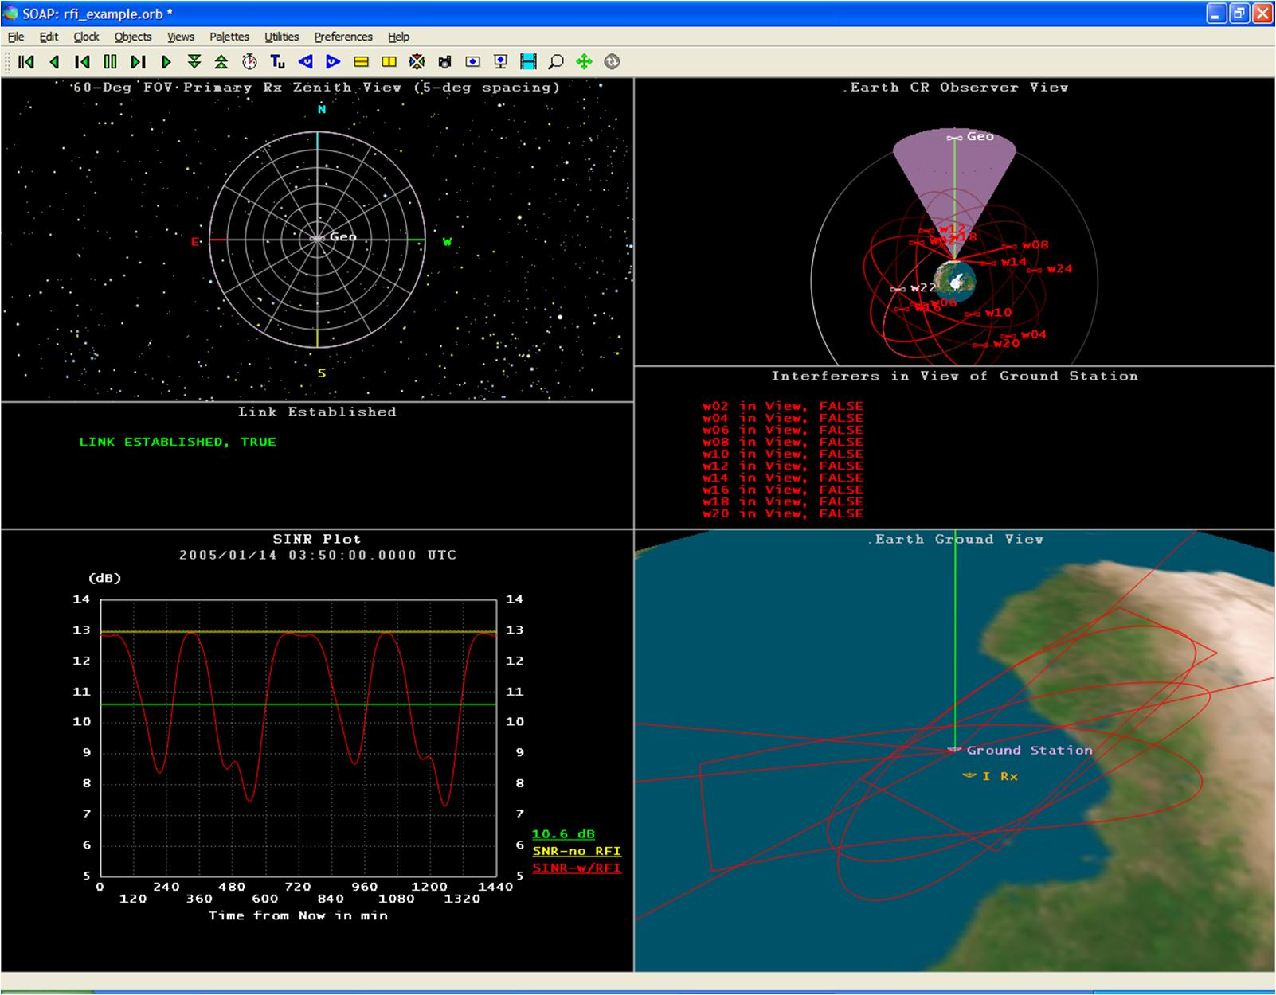
Spectrum Sharing Between Satellite Networks
OneWeb
SpaceX
Large constellations of non-geosynchronous orbit (NGSO) satellites proposed
  SpaceX, OneWeb, Telesat, DARPA Blackjack...
De-confliction with priority systems in geosynchronous orbits (GSO) and other systems in NGSO
  Traditional de-confliction approaches insufficient
    Geographically separated ground stations
    Tolerating occasional interference events
WRC-19 AI 7
Constellation Interference Mitigation Modeling
Notes:
Large constellations of non-geostationary satellites proposed in bands already heavily used by satellite operators
-SpaceX, OneWeb, Telesat, DARPA Blackjack etc.
-Aerospace assisting geostationary incumbents in assuring their systems with priority are protected
-Aerospace assisting non-geostationary incumbents in identifying required protections
-Aerospace assisting prospective large constellation operators with understanding challenges
Challenge: traditional approach of de-conflicting non-geostationary systems relies on geographically separated ground stations and tolerating occasional interference events
-Dramatic increase in number of satellites and geographically diverse ground stations inconsistent
-New operators planning to build flexibility and redundancy into their design to tolerate frequent interference with other operators
-Increase in interference events unacceptable for traditional operators
-Can insist on protections for priority operators, but substantial economic pressure to accommodate
-New operators may need to choose different bands

Slide 8
Conclusions
Myriad of spectrum uses providing valuable services
Clearing bands for new uses is increasingly impractical
Spectrum sharing is critical, but no one-size-fits-all solution
Good infrastructure needed to manage spectrum resources
Spectrum policy must strike a balance between…
  Assurances for operators and flexibility for technology and growth
  Efficient use of spectrum and cost/complexity
  Efficient use of spectrum and user privacy
  Short-term and long-term potential

