Slide 1
Space Policy Webinar: Launch Uncertainty
Dr. Grant Cates
April 30, 2019

Slide 2
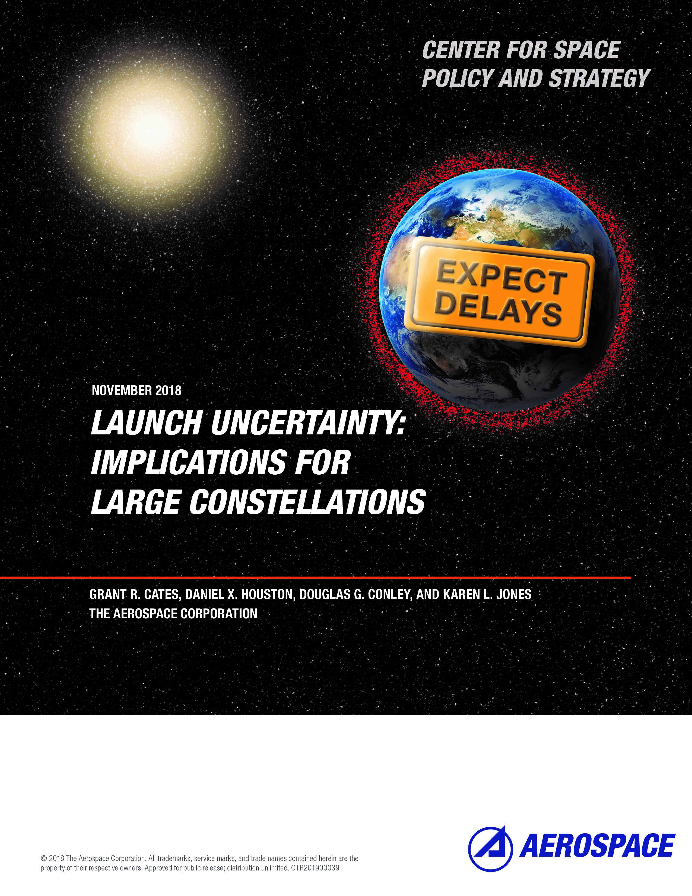
Introduction and Overview
The Constellations
Regulatory Fielding Requirements
Future Launch Demand
Deployment
Sustainment
Potential Launch Capacity Shortfall
Consequences of Launch Delays
Revenue and Profitability Impacts
Opportunities and Threats for Customers and Stakeholders
Launch Delay Risk Management
Frequency and Sources of Delays
Slip Charts
Simulation Modeling
Policy Implications
Facilitating Launch Demand Situational Awareness
Facilitating Constellation Success
Conclusions
References In Backup Charts
Link to paper:
https://aerospace.org/paper/launch-uncertainty-implications-large-constellations

Slide 3
NGSO (Non-Geostationary-Satellite Orbit) Constellations
FCC Filings
~20,000 Satellites Proposed
~13,000 Approved by FCC
FCC Constellation Deployment Rules
50 percent of satellites must be deployed within six years of license approval and 100 percent within nine years.
Satellites must be operational to be considered part of the count.
Failure to meet a milestone results in the constellation being limited to the number of satellites in operation on the milestone date.
The licensee would have to file a license modification in order to deploy and operate additional satellites above that new limit.
The rules in place prior to September 2017 required an entire constellation to be deployed within six years. Failing such, the grantees’ entire authorization was voided.
The rule change prompted OneWeb to expand the number of proposed satellites.
Thousands of NGSO satellites are needing to be launched.

Slide 4
Future Launch Demand
Deployment Launches
The FCC does not require licensees to provide launch plans, nor does it require sufficient information to make accurate estimates of future launch demand.
Estimated total number of deployment launches based upon public information and simplifying assumptions.
At least one launch per orbital plane
Fewer satellites per launch for higher inclination orbits
The peak annual launch rate estimate assumes:
FCC approvals in 2018
Deployment plans achieve FCC milestones with at least one year of margin to protect for launch delays.
50 percent of satellites deployed by 2023
100 percent deployed by 2026
Assumed flight rate would ramp up over time and peak in 2023
Developed estimates for four scenarios relative to the percentage of proposed satellites that actually end up needing to be launched:
25% Scenario (If ~5,000 satellites need to be launched)
50% (~10,000 satellites)
75% (~15,000 satellites)
100% (~20,000 satellites)
Wide range of future launch demand due to uncertainties:
How many proposals will be approved by the FCC?
How many satellites will actually end up needing to be launched?
How many satellites will be launched by a single rocket?
What launch tempo will be achieved?
Will deployment milestones be met ahead of time, just in time, or not be met but waived?
The estimated total number of launches required for initial deployment ranges from zero to several hundred.
Estimated peak annual flight rate for initial deployment launches ranges from zero to near one hundred.

Slide 5
Potential Launch Capacity Shortfall
Initial Deployment
We first estimated the present launch capacity for all medium and heavy launch vehicles likely to be used for the initial deployment.
Approximately 80 medium-to-heavy class launches per year.
We then considered existing demand i.e., how many launches are typically required on an annual basis by reviewing recent historical data on government launches and FAA projections for commercial GEO satellites.
Approximately 50 medium-to-heavy class launches per year for missions other than the proposed NGSO constellations.
Estimated current launch availability for NGSO constellation deployment calculated by subtracting existing demand (50 launches) from existing capability (80 launches).
Approximately 30 launches per year currently available to deploy proposed constellations.
Uncertainty regarding a potential launch capacity shortfall driven by:
How many proposals will be approved by the FCC?
How many satellites will actually end up needing to be launched?
How many satellites will be launched by a single rocket?
What launch tempo will be achieved?
Will deployment milestones be met ahead of time, just in time, or not be met but waived?
What is the existing launch capacity?
What is the existing launch market demand exclusive of proposed NGSO constellations?
Estimated peak annual launch rate shortfall for initial deployment launches ranges from zero (and potential overcapacity) to near one hundred.
Given that approximately 65% of the proposed ~20,000 satellites have been approved by the FCC, there could be a future launch capacity shortfall of ~50 launches per year.

Slide 6
Consequences of Launch Delays
When the FCC approves a proposed constellation, the race is on to meet the six-year and nine-year deployment milestones.
As proposers generally wish to have the FCC license in hand before too much investment is committed, the design of the constellation may not be complete.
Thus, the race includes design, development, securing capital funding, constellation deployment, and sustainment.
Failure to meet an FCC milestone could stop a constellation deployment and result in loss of viability.
Revenue and Profitability
Business plans should address the possibility that revenue will be delayed, potentially by years, and additional rounds of financing may be needed, as was the case with the Iridium NEXT constellation.
Opportunities and Threats for Customers and Stakeholders
Hosted Payloads
Launch Service Providers
Spaceports and Launch Ranges
Geostationary Satellites
Orbital Debris and Removal Services
Significant launch delays can be devastating because constellation performance and viability depends heavily on the number of operational satellites in orbit.

Slide 7
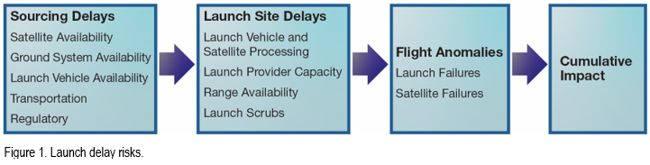
Launch Delay Risk Management
Frequency and Sources of Delays
Risk management begins with gaining an understanding of potential launch delays and how they can impact constellation deployment milestones.
Historical data is analyzed to develop probabilities for individual launch delays and the duration of the delays. Simulation modeling is used to determine the cumulative effects of launch delays.
Launch delays remain a common theme across the space launch industry.
During the three-year period of calendar years 2015–2017, 66 out of 71 U.S. launches were delayed according to Spaceflight Now’s launch history log.
Delays range from a single day to years. Causes of delays vary, and we have grouped them into three categories: sourcing delays, launch site delays, and flight anomalies.
All launches are subject to delay risk.

Slide 8
Facilitating NGSO Success
Regulatory Relief
Regulatory relief occurred in 2017 with respect to constellation deployment milestones:
From: 100% needing to deployed in 6 years
To: at least 50% deployed in 6 years; 100% deployed in 9 years
Further relief in the form of changes or waivers may prove to be necessary.
For example, SpaceX has already sought a waiver to the deployment milestones for their Starlink constellation. The FCC at present has denied this waiver, but SpaceX may resubmit a request in the future.
Launch Demand Situational Awareness
Reasonably accurate launch forecasts are needed to successfully support a potential large increase in launch demand.
Launch service providers and launch ranges benefit by knowing what demand to plan for.
Inaccurate forecasting increase risk of capacity not matching demand.
An inter-agency working group chartered to forecast launch demand could help improve understanding of the U.S. launch market and worldwide launch demand.
Bring together future launch demand information from the FAA, the Department of Defense, NASA, the FCC, and private industry sources.
Produce estimates for planned launches as well as estimates for the expected actual number of launches based upon all risk factors.
Success of NGSO constellations may require proactive support from the government.

Slide 9
Conclusions
Large NGSO satellite constellations can potentially help close the digital divide, demonstrate U.S. commercial leadership in space, and provide unique satellite service opportunities for government and private sector customers.
Whether these large constellations of satellites can be produced and deployed remains to be seen.
Their arrival depends upon many factors, including technical viability, availability of financing, ramping up U.S. launch capacity, and the herculean efforts required to produce, launch, and maintain unprecedented numbers of satellites.
Launch delay risks will be pervasive throughout development and deployment, and the cumulative impact of launch delays to large constellations will likely be measured in years.
Delay risks should be thoroughly analyzed, constantly monitored, and communicated to the NGSO stakeholders as well as the government agencies that rely upon timely satellite launches to meet their mission needs.

Slide 10
Launch Uncertainty: Implications for Large Constellations
Dr. Grant Cates Dr. Dan Houston
Doug Conley
Karen Jones
April 15, 2019

Slide 11
Future Launch Demand
Sustainment – Design Life Replacement Cycles
Estimate for sustainment launches based upon specified satellite design life.
7 years for OneWeb
5-7 years for Starlink (Table 3 reflects 6-year design life for Starlink related launches)
Assumed replacement cycles will be accomplished using medium to large launch vehicles capable of deploying multiple satellites at a time similar to the initial deployment approach.
Achieved satellite lifetimes may be longer (or shorter) than designed lifetimes.
A study of military and civil satellites having various orbits found that the average mission’s actual life exceeds its design life by 2.6 to 4.9 years.
The 125 LEO satellites in this study had an average design lifetime of less than three years.
Satellites in LEO typically require additional propellant for orbit maintenance compared to satellites operating in higher orbits.
Uncertainty in design versus achieved satellite lifetime has enormous implications for future launch demand.
Key Point – Annual launch rates for replacement cycles could be similar to the annual launch rates for the initial deployment if satellite design lifetimes are similar to the time required for deployment.

Slide 12
Future Launch Demand
Sustainment – Replacing Individual Failed Satellites
The potential need to replace individual failed satellites on short notice could create an ideal market for small launchers.
Size of the market will depend upon the total number of satellites launched as well as their failure rates and number of on-orbit spares.
Commercial satellites have historically had failure rates of three-to-five percent in the first year on orbit reducing to one percent in subsequent years. These figures may not be applicable to large constellations.
Wide range of future launch demand for small launches due to uncertainties:
How many proposals will be approved by the FCC?
How many satellites will actually end up needing to be launched?
Will deployment milestones be met ahead of time, just in time, or not be met but waived?
How many on-orbit spares will be included in the initial deployment?
What will the satellite failure rates be?
Assuming a 1% failure rate and with no on-orbit sparing, the estimated number of annual launches once full deployment is reached could range from zero to a couple hundred.
Significant uncertainty in both if and when such demand will materialize.
The number of satellites actually deployed and their failure rate will be a key demand driver for the small launch market.

Slide 13
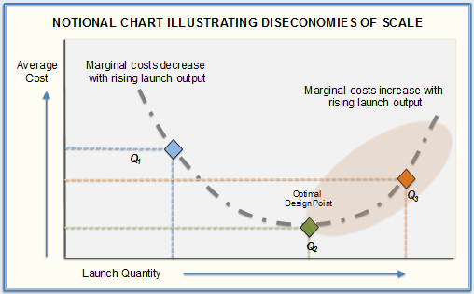
Launch Diseconomies of Scale
Challenge of optimizing launch vehicle availability
Economies of scale refers to reduced costs per unit that arise from increased total output of a product.
Diseconomies of scale might occur after output quantity exceeds an optimal design point.
Additional workforce and/or capital expenditures for increased manufacturing output and launch site capacity throughput.
Marginal cost increases could increase launch prices over time and potentially:
Dampen future launch demand.
Cause constellation deployment & sustainment cost overruns leading to need for additional capital
Economies and diseconomies extend to satellite manufacturers as well as launch service providers. Key questions:
What are optimal manufacturing levels for satellite and launch vehicle manufacturers?
What are optimal launch rates?
How will these optimal rates change over time?
How long will it take the industries to adjust when diseconomies occur?
All market participants and regulators should watch closely to observe any adverse trends.

Slide 14
Consequences of Launch Delays
When the FCC approves a proposed constellation, the race is on to meet the six-year and nine-year deployment milestones.
As proposers generally wish to have the FCC license in hand before too much investment is committed, the design of the constellation may not be complete.
Thus, the race includes design, development, securing capital funding, constellation deployment, and sustainment.
Failure to meet an FCC milestone could stop a constellation deployment and result in loss of viability.
Revenue and Profitability
Business plans should address the possibility that revenue will be delayed, potentially by years, and additional rounds of financing may be needed, as was the case with the Iridium NEXT constellation.
Opportunities and Threats for Customers and Stakeholders
Hosted Payloads:
Entities desiring to have hosted payloads on constellations need to be prepared for delays.
Ensure existing capability is maintained until hosting constellation is operational.
Launch Service Providers
Tremendous opportunity for growth in the launch industry
Risk that growth will not be as great as planned
Risk of sharp decrease if an FCC milestone miss halts a deployment.
Spaceports and Launch Ranges
Growing number of spaceports. Increasing number of active launch complexes at the launch ranges.
How much investment should be made to enable what level of increase?
Geostationary Satellites
Potential resurgence in orders for GEO satellites if constellations stumble
Orbital Debris and Removal Services
Subject to not having significant numbers of customers (i.e, satellites needing to be deorbited) for years.
Significant launch delays can be devastating because constellation performance and viability depends heavily on the number of operational satellites in orbit.

Slide 15
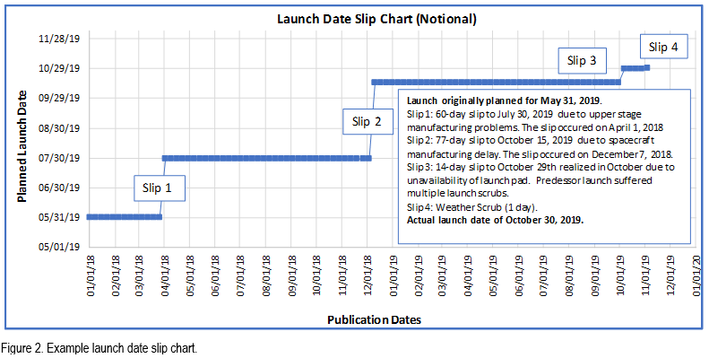
Slip Charts: Documenting Launch Delay History
“If you can’t measure it, you can’t improve it.” (Peter Drucker)
Launch delays need to be measured and analyzed in order to develop risk estimates for future launch delays.

Slide 16
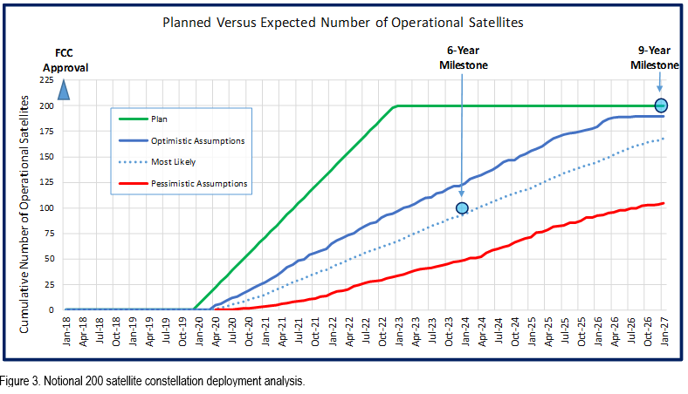
Simulating Constellation Deployment
A discrete event simulation based analysis can take into account all risk factors associated with the deployment (as well as sustainment) of a constellation and provide actionable information to improve expected outcomes.
The cumulative impact of launch delays for large constellations will likely be measured in years.

Slide 17
References
FCC Fact Sheet, “Updating Rules for Non-Geostationary-Satellite Orbit Fixed-Satellite Service Constellations Report and Order and Further Notice of Proposed Rulemaking,” IB Docket No. 16-408, September 7, 2017.
47 CFR § 25.164(b)(1) and 47 CFR § 25.164(b)(2).
Erwin, S. “Commercial space technologies a key theme in Air Force intelligence and data strategy,” SpaceNews, August 2, 2018.
FAA “The Annual Compendium of Commercial Space Transportation: 2018,” January 2018, p. 47.
Statement of Commissioner Michael O’Rielly, Re: Update to Parts 2 and 25 Concerning Non-Geostationary, Fixed-Satellite Service Systems and Related Matters, IB Docket No. 16-408, September 27, 2017.
Brown, N., et al. Spacecraft Lifetime Study, Aerospace Report Number TOR-2010(8582)-3. The Aerospace Corporation, El Segundo, CA, 2010.
Gould, Allen J., and Orin M. Linden. “Estimating satellite insurance liabilities.” Casualty Actuarial Society. 2000.
Saleh, Joseph Homer, and Jean-François Castet. Spacecraft reliability and multi-state failures: a statistical approach. John Wiley & Sons, 2011.
McIntyre, S., et al. “A Commercially Driven Design Approach to UK Future Small Payload Launch Systems”; BIS-RS-2016-17; October 2016.
Henry, C. “OneWeb shifts first launch to year’s end,” SpaceNews, May 1, 2018.
FAA, “The Annual Compendium of Commercial Space Transportation: 2018”; January 2018, pg. 45.
Review of Spaceflightnow.com’s Launch Log.
Gwynne Shotwell interview with CNBC, May 22, 2018.
Henry, C. “Iridium raising new debt to cover late Aireon payments,” SpaceNews, February 26, 2018.
Northern Sky Research; “Satellite Constellations: Too Much of a Good Thing?”; August 1, 2018.
OneWeb Satellites, http://onewebsatellites.com/ (accessed August 31, 2018).
Sargent, A-W. “Commercial Satellite Sector Sees Upside to New Space Policy Hopeful of ITAR Reform, Greater Stake in U.S. Roadmap for Space,” ViaSatellite, January 1, 2011.
Erwin, S. “Senate defense bill proposes big funding boost for military LEO constellation,” SpaceNews, June 7, 2018.
Henry, C. “Iridium raising new debt to cover late Aireon payments,” SpaceNews, February 26, 2018.
Foust, J. “The launch industry depression: when will it end?” Space Review, March 17, 2003.
https://www.faa.gov/data_research /commercial_space_data/licenses/#operatorLicenses, accessed August 30, 2018.
Satellite Industry Association, “2018 State of the Satellite Industry Report,” June 2018.
Werner, D. “Rise of the megaconstellations breathes life into active debris removal schemes,” SpaceNews, April 18, 2018.
Henry, C. “Kepler Communications opens launch bids for Gen-1 LEO constellation,” SpaceNews, August 29, 2018.
https://spaceflightnow.com/launch-log/, accessed June 14, 2018.
Lucko, G., L. G. Araújo, and G. R. Cates. “Slip Chart–Inspired Project Schedule Diagramming: Origins, Buffers, and Extension to Linear Schedules.” Journal of Construction Engineering and Management (2015): 04015101.
Law, A. M. Systems Modeling and Analysis, 5th Edition, McGraw Hill, 2013.
Cates, G. R. “Launch Probability in NASA Space Launch System,” Arena Newsletter Issue 18: Taking the Uncertainty Out of Project Management, October 2017.
Cates, G. R., and Mansooreh Mollaghasemi. “A discrete event simulation model for assembling the international space station.” Proceedings of the 37th Conference on Winter Simulation. Winter Simulation Conference, 2005.
The Aerospace Corporation. “Accuracy Is Worth Millions: $18 Million Saved by Accurately Predicting Future Launch Rates,” Delivering Innovation, Issue 12, March 2018.
Trump, D. J. “Space Policy Directive-2: Streamlining Regulations on Commercial Use of Space,” May 24, 2018 (https://www.whitehouse.gov/presidential-actions/space-policy-directive-2-streamlining-regulations-commercial-use-space/).
Jones, K. L. “Public-Private Partnerships: Stimulating Innovation in the Space Sector,” The Aerospace Corporation, April 2018.
Federal Communications Commission, “Updating to Parts 2 and 25 Concerning Non-Geostationary, Fixed-Satellite Service Systems and Related

Slide 18
References
Ibid.
Ibid.
Statement of Commissioner Michael O’Rielly, Re: Update to Parts 2 and 25 Concerning Non-Geostationary, Fixed-Satellite Service Systems and Related Matters, IB Docket No. 16-408.
Henry, C. “OneWeb asks FCC to authorize 1,200 more satellites,” SpaceNews, February 26, 2018.
Henry, C. “OneWeb shifts first launch to year’s end,” SpaceNews, May 1, 2018.
GAO-15-657, “GPS: Actions Needed to Address Ground System Development Problems and User Equipment Production Readiness,” September 2015.
GAO-18-74, “Global Positioning System: Better Planning and Coordination Needed to Improve Prospects for Fielding Modernized Capability,” December 2017.
Strong, S., and T. Braden. In Peril: A Daring Decision, a Captain’s Resolve, and the Salvage that Made History, CreateSpace Publishing, 2003.
https://spaceflightnow.com/launch-schedule/, accessed March 16, 2018.
Foust, J. “Commerce Department pressing ahead with commercial space regulatory reform,” SpaceNews, March 5, 2018.
Braun, B., and E. Sims. The Aerospace Corporation; “Trespassing on the Final Frontier: Regulatory Challenges for New Space Entrants”; June 2018.
Henry, C. “Arianespace cancels Ariane 5 launch over ISRO satellite issue,” SpaceNews, April 24, 2018.
Space.com staff. “Boeing’s Union Strike Delays Satellite Launch Plans, SPACE.com, November 2, 2005.
Clark, S. “Launches from Kourou temporarily suspended by social unrest,” SpaceNews, March 23, 2017.
Aerostar Environmental Services, Inc. “Environmental Assessment for the Operation and Launch of the Falcon 1 and Falcon 9 Space Vehicles at Cape Canaveral Air Force Station, Florida,” Orlando, Florida, November 2007.
“Final Environmental Assessment for Multi-Use of Launch Complexes 39A and 39B,” John F. Kennedy Space Center, Florida, November 1, 2013.
“Final Environmental Assessment, Falcon 9 and Falcon 9 Heavy Launch Vehicle Programs from Space Launch Complex 4 East,” Vandenberg Air Force Base, California, March 1, 2011.
“Final Environmental Impact Statement, SpaceX Texas Launch Site,” May 2014.
“Final Environmental Assessment, Blue Origin Orbital Launch Site at Cape Canaveral Air Force Station, Florida,” November 2016.
https://www.fema.gov/possible-consequences-not-following-national-environmental-policy-act-process, accessed July 13, 2018.
David, L. “How Much Air Pollution Is Produced by Rockets?” Scientific American, November 29, 2017.
Ross, M., and J. A. Vedda. “The Policy and Science of Rocket Emissions,” Center for Space Policy and Strategy, The Aerospace Corporation, April 2018.
Calais, E., and J. B. Minster. “GPS, earthquakes, the ionosphere, and the Space Shuttle.” Physics of the Earth and Planetary Interiors 105.3-4 (1998): pp. 167-181.
Li, G., et al. “Daytime F-region irregularity triggered by rocket-induced ionospheric hole over low latitude.” Progress in Earth and Planetary Science 5.1 (2018): p. 11.
Cates, G. R. “Space shuttle launch probability analysis: Understanding history so we can predict the future.” Aerospace Conference, 2014 IEEE. IEEE, 2014.
Cates, G. R., and Kara Schmitt. “The Aerospace launch probability simulation.” Aerospace Conference, 2016 IEEE. IEEE, 2016.
Amos, J. “Galileo satellites experiencing multiple clock failures,” BBC, January 18, 2017.
Clark, S. “Four more Galileo navigation satellites ride Ariane 5 rocket into orbit,” Spaceflight Now, December 13, 2017.

